Slide 1
GEOG 475 Advanced GIS Lab1
Zhenlei Song, Ph.D Student
Department of Geography
Email: songzl@tamu.edu
Office: CSA 301F

Slide 2
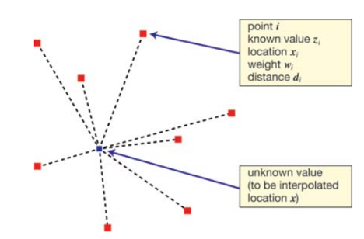
Interpolation
From known points to predict unknown points’ values.
Use case?
Notes:
Think of a few scenarios where you would use spatial interpolation.
- You only have a few data points from Brazos County climate stations, but you need to produce a choropleth map for the entire county. **(Lab1.1)**
- You only have a raster data layer of `Digital Elevation Model (DEM)` at a resolution of 30m, but to save bandwidth, you need to produce raster layers with multiple spatial resolution (90m, and 200m). **(Lab1.2-1)**
- You only have a raster data layer of `DEM` at 30m resolution, but you need to produce a graph of elevation profile along a transect line. **(Lab1.2-2)**
- You have a point vector layer (300 * 300 fishnet structured) of `DEM`, whose values were extracted from the original raster layer at 30m resolution, but you need to evaluate how well the point data layer represents the original raster layer. **(Lab1.3)**
Questions:
What do we need to know about control points and target points to get target value?

Slide 3
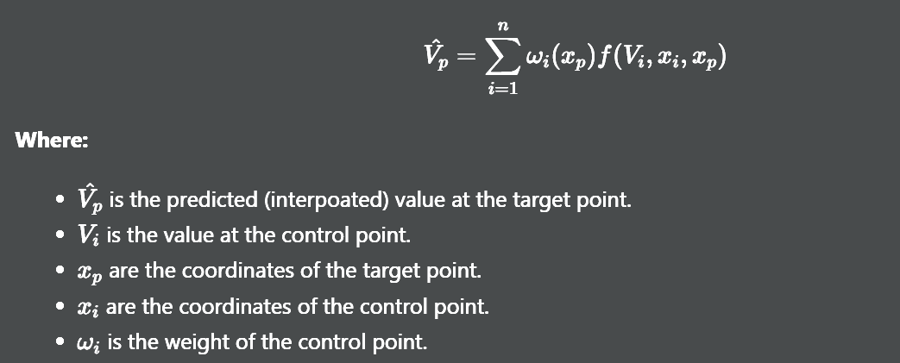
Interpolation
Notes:
From control points:
location, or and shape, extent
values
From target points:
location, or and shape, extent
From algorithms:
weights
function f.

Slide 4
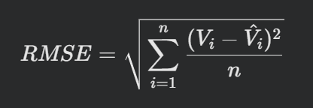
Evaluation - RMSE
Residual
Square
Average
Square root
Unit consistent
Differentiable
Magnitude sensitive
Notes:
How do we know if and how accurate our predicted results are?
Compared to what?
How to compare?
Benefits of RMSE compare to other functions?
Keeps the same units as the inputs
It’s differentiable, useful when serving as loss function in ML
It’s sensitive to its magnitude.
Lower RMSE means closer to ground truth, means more accurate.
Question not that related to this lab:
Is it always good news when RMSE is super low?

Slide 5
Data Splitting
If you are a parent, do you want your child to be able to deal with some unknown situations besides what you told them?
Suppose there are 1000 data points. We only get to know values from 100 of them. Uncertainty on the rest 900.
Train with all 100 points, the training RMSE is 0.01, RMSE on the 900 unknown points is 0.25.
Train with 75 points, and tune training params with 25 points. So that training RMSE is 0.05, RMSE on the 900 unknown points is 0.1.
Notes:
Don’t spoil your child.
Don’t overfit your model.
So split it and at least you know it’s overfitten.
There are other approaches that counter-measure this phenomenon.

Slide 6
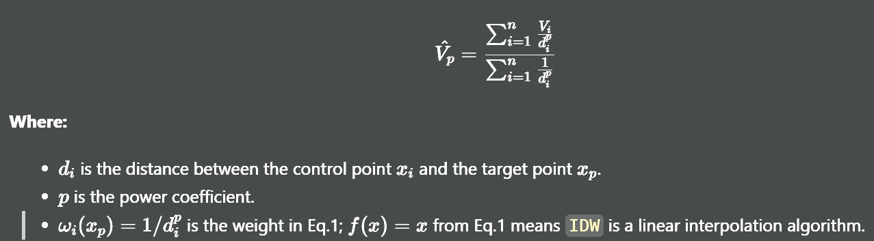
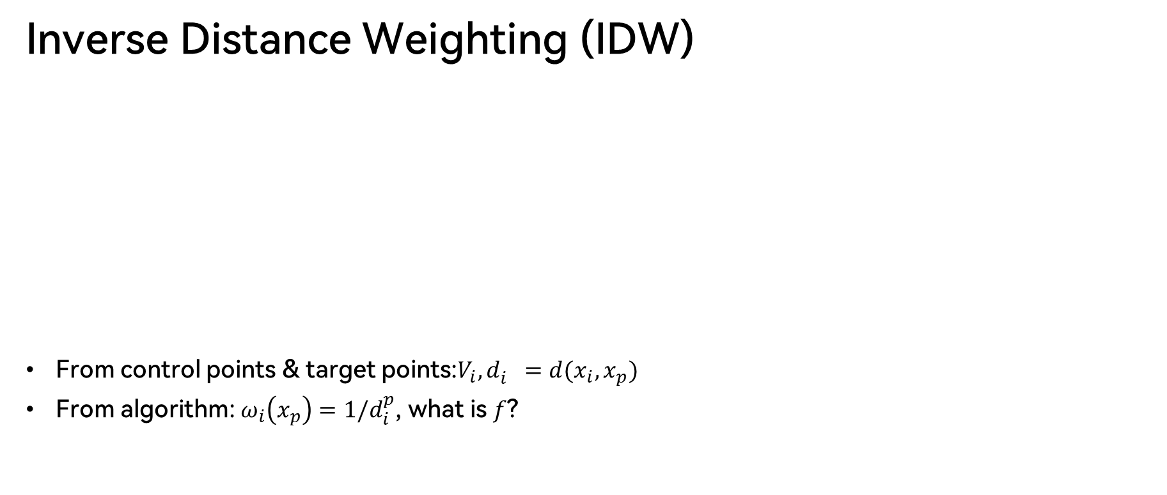
Interpolation Algos - IDW
Inverse Distance Weighting (IDW)
From control points & target points:$V_{i}, d_{i}^{}=d(x_{i}, x_{p})$
From algorithm: $ω_{i}\left(x_{p}\right)=1/d_{i}^{p}$, what is $f$?

Slide 7
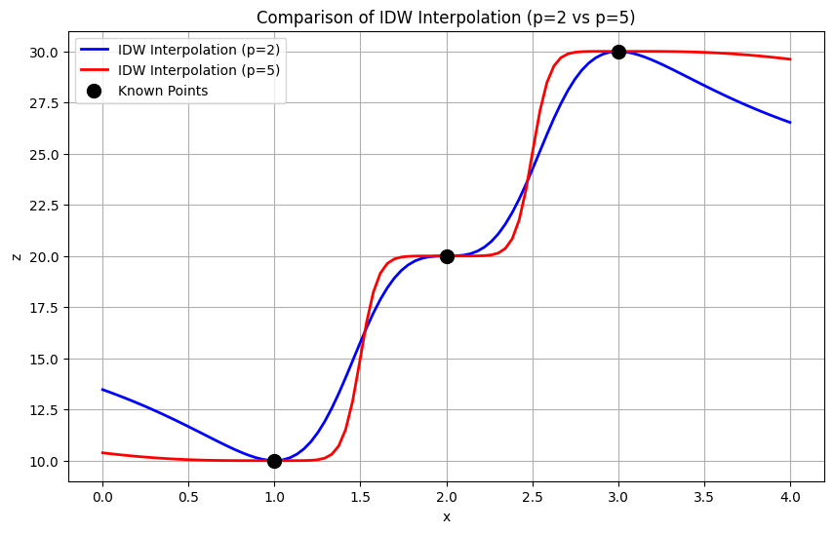

Interpolation Algos - IDW
The $p$
Constant p value, different control points:
More weights on points that are closer to the target points.
Different p values, same control point:
More weights on higher p values.
Try to prove and interpret this in your experiments when tuning the P value.
Notes:
It’s a good example for me to explain the grading policy
If you just follow the instructions and finish all steps, and show me screenshot in your report
You will only get 50%
If you tune with the parameters, here the p value, and explain your findings with proper reasoning,
You can get 85 – 90 %
If you can interpret everything by referring to the formula.
For example, I changed the p value from this to this, and because of which equation, the weights on this control point should increase or decrease.
So that the RMSE will increase / decrease. And that means…

Slide 8
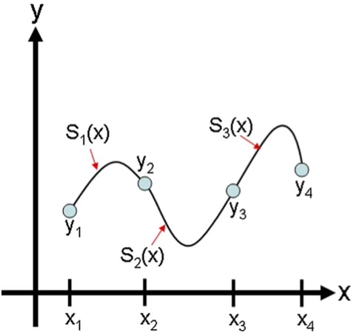
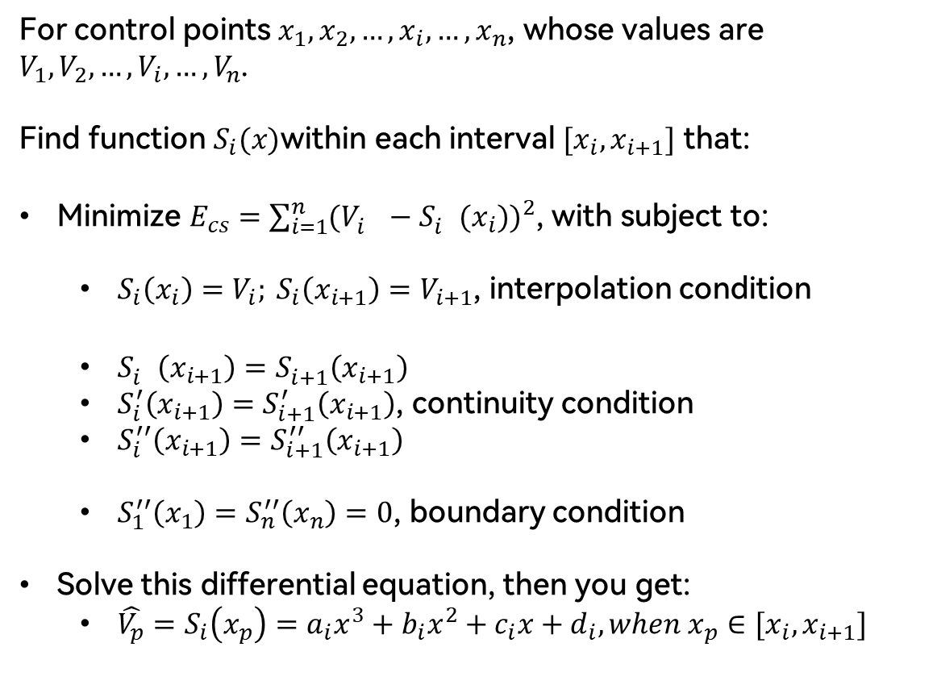
Interpolation Algos – Cubic-Spline
For control points $x_{1}, x_{2}, …, x_{i}, …, x_{n}$, whose values are $V_{1}, V_{2}, …, V_{i}, …, V_{n}$.
Find function $S_{i}(x)$within each interval $[x_{i}, x_{i+1}]$ that:
Minimize $E_{cs}=\sum_{i=1}^{n}{{(V_{i}^{}−S_{i}^{}(x_{i}))}^{2}}$, with subject to:
$S_{i}\left(x_{i}\right)=V_{i}; S_{i}\left(x_{i+1}\right)=V_{i+1}$, interpolation condition
$S_{i}^{}\left(x_{i+1}\right)=S_{i+1}^{}\left(x_{i+1}\right)$
$S_{i}^{′}\left(x_{i+1}\right)=S_{i+1}^{′}\left(x_{i+1}\right)$, continuity condition
$S_{i}^{′′}\left(x_{i+1}\right)=S_{i+1}^{′′}\left(x_{i+1}\right)$
$S_{1}^{′′}\left(x_{1}\right)=S_{n}^{′′}\left(x_{n}\right)=0$, boundary condition
Solve this differential equation, then you get:
$\hat{V_{p}}=S_{i}\left(x_{p}\right)=a_{i}x^{3}+b_{i}x^{2}+c_{i}x+d_{i}, when x_{p}∈[x_{i},x_{i+1}]$
Notes:
Cubic-Spline is designed to minimize the MSE at the beginning.
So the RMSE it come up with will always be the lowest naturally.
Again, is this good news?
Native Cubi-Spline algorithm can ensure that the interpolated function passing through all control points (training points).
It means super low RMSE and super susceptible to overfitting at the same time.
Can we optimize this algo?

Slide 9
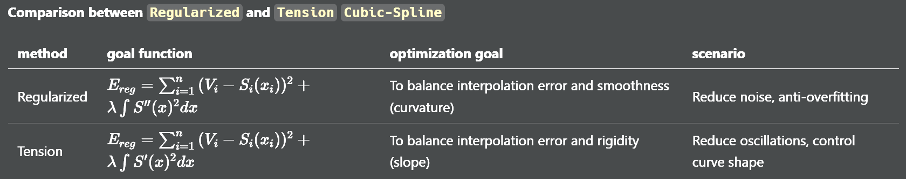
Cubic-Spline – anti-overfitting
Notes:
We can add penalty component to this err function.
When overfitting, This cubic polynomial function leads to many unnecessary SHARP curves in the function
So we can depress on the overall first order or second order derivatives to balance between accuracy and robustness.

Slide 10
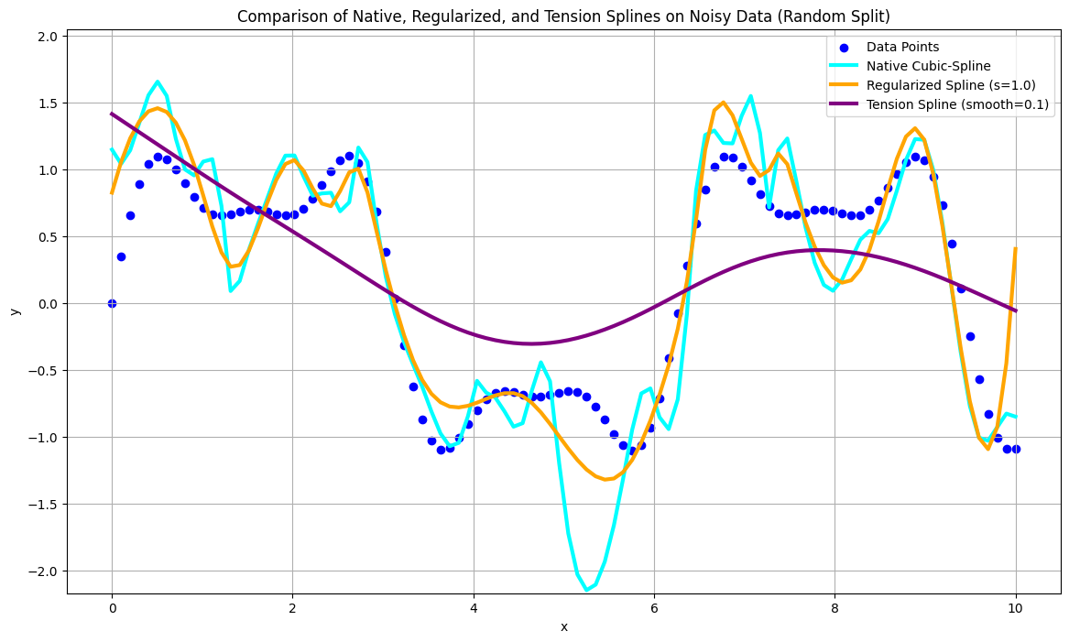
Cubic-Spline – anti-overfitting
Notes:
Blue dots represent all ground truth points, including training and testing.
You can tell that the cyan line, which is the interpolated cs algo. It adds some super sharp curves.
There is nothing wrong about the sharp curves themselves, but the error it’s causing at testing points.
For example the middle grid here. The cyan line is far from actual data points.
But if we depress the curvature by using regularized component in the loss function.
The overall rmse is reduced by removing some sharp curves.
And even harder depression on 1st order derivatives, the tension spline is more rigid, more flat than both the native and the regularized spline.
Again, try to compare the differences in RMSE and interpret the differences you find in your report.
It would be better if you can combine the characteristics from the formula to explain your findings.

Slide 11
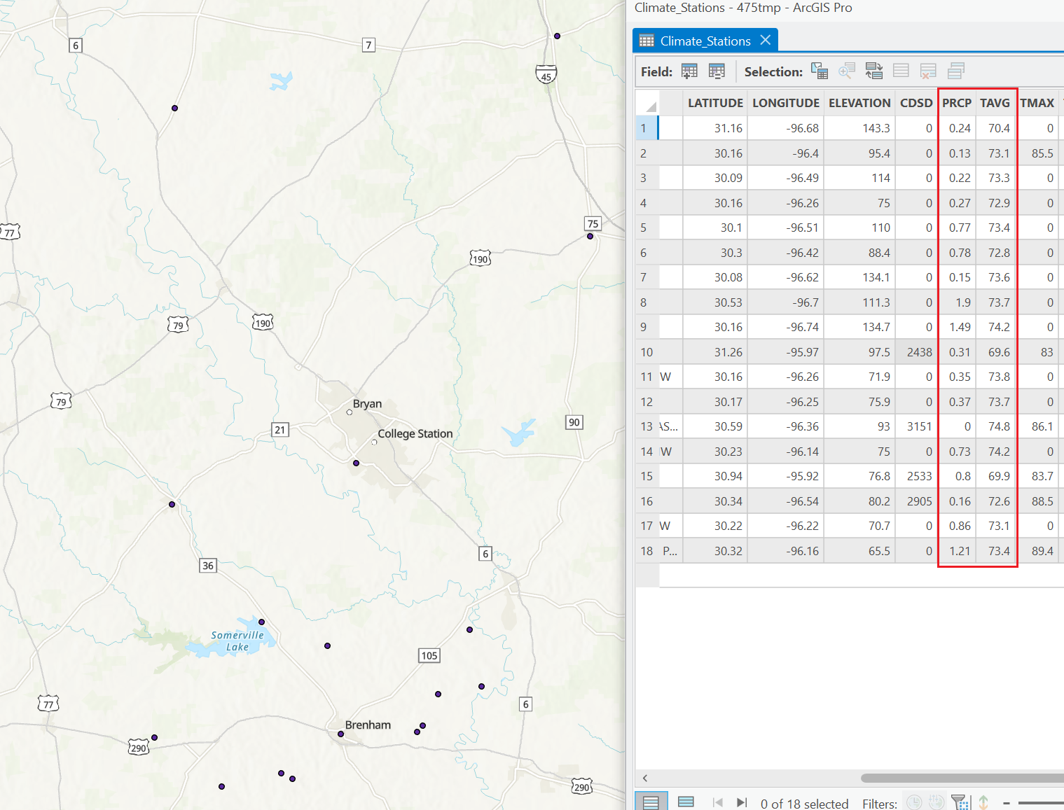
Source Data – Climate Points

Slide 12
Part1.Tasks
Load Climate Station Point data and split into Training and Evaluating sets.
Apply interpolation algorithms on training set.
IDW
Cubic-Spline
Extract values from the interpolated layer onto the evaluating points.
Compare the predicted values and the ground truth by calculating RMSE
Tune params in interpolation, analyze the changes and interpret your findings.

Slide 13
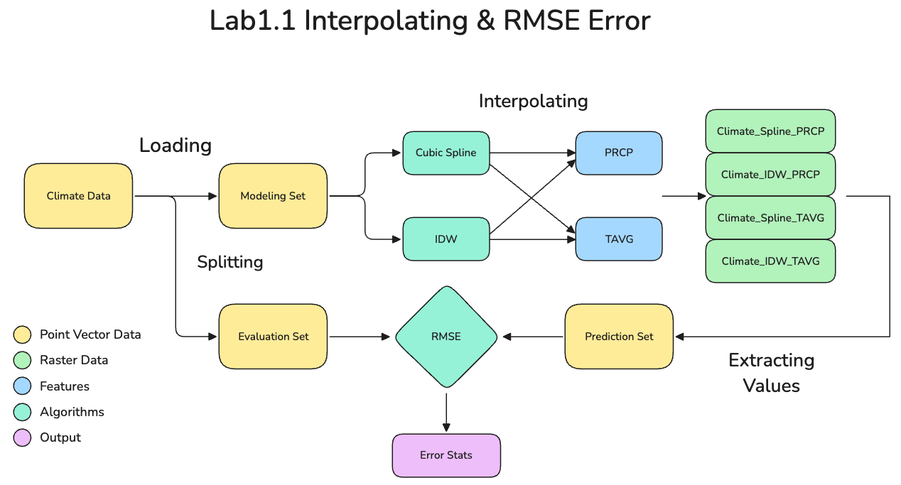
Part 1. Interpolation

Slide 14
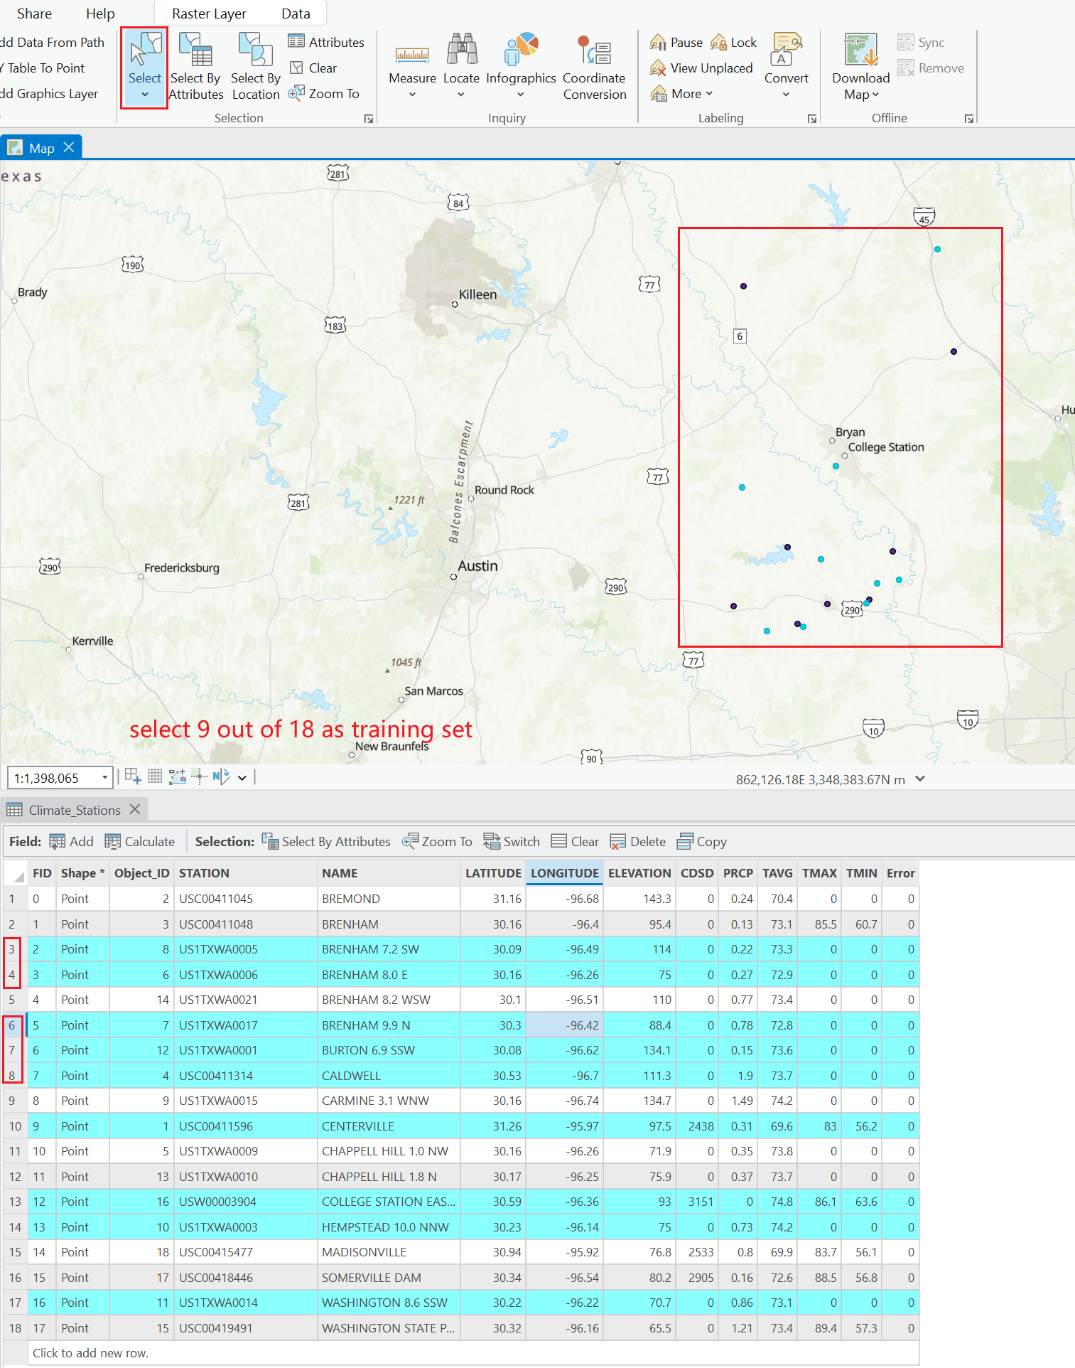
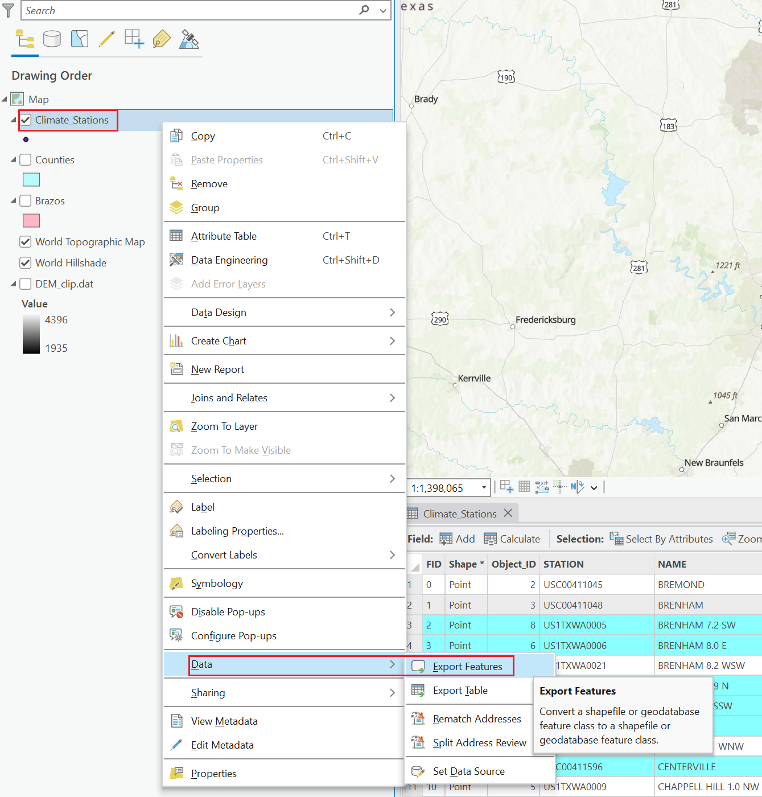
Part 1. Interpolation

Slide 15
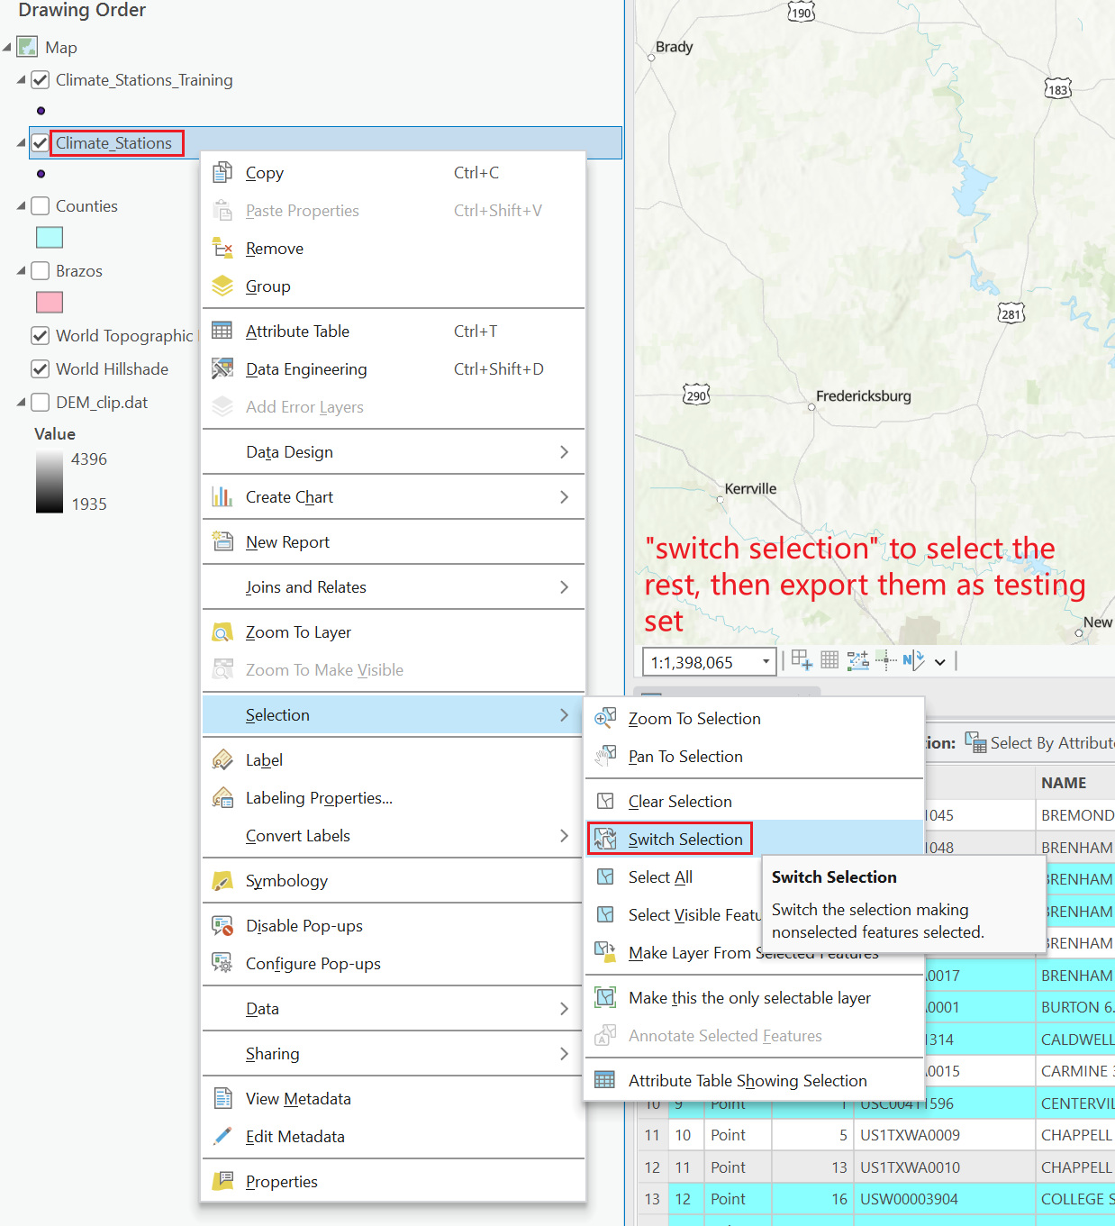
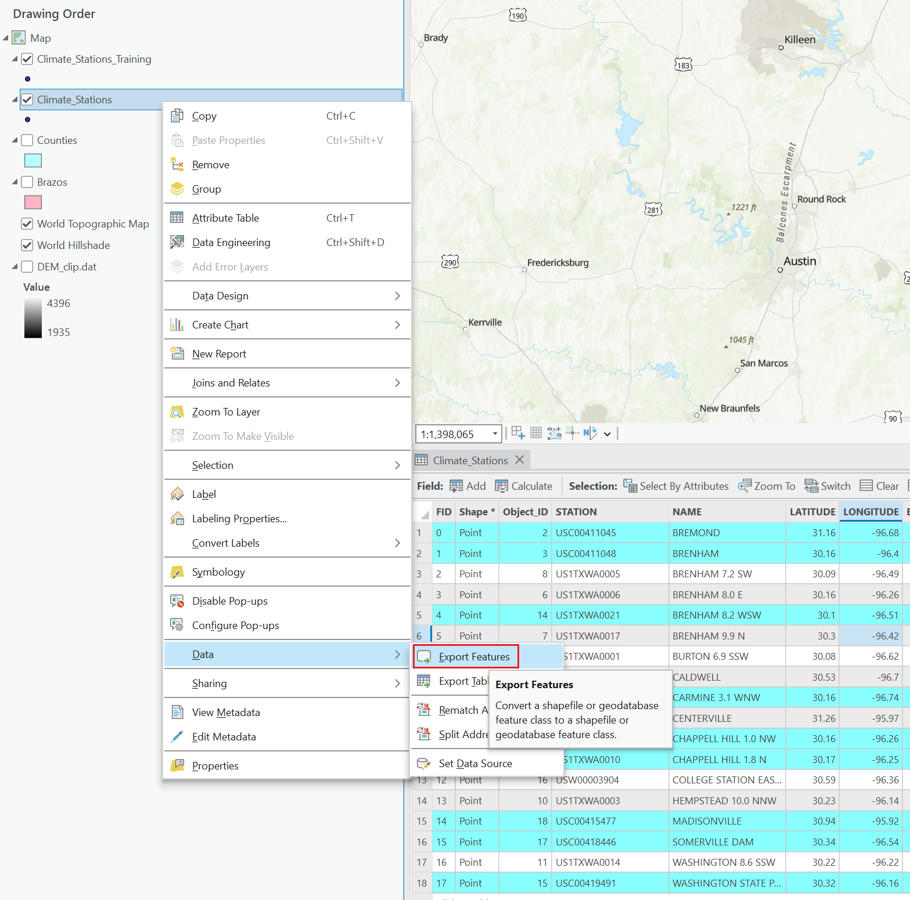
Part 1. Interpolation

Slide 16
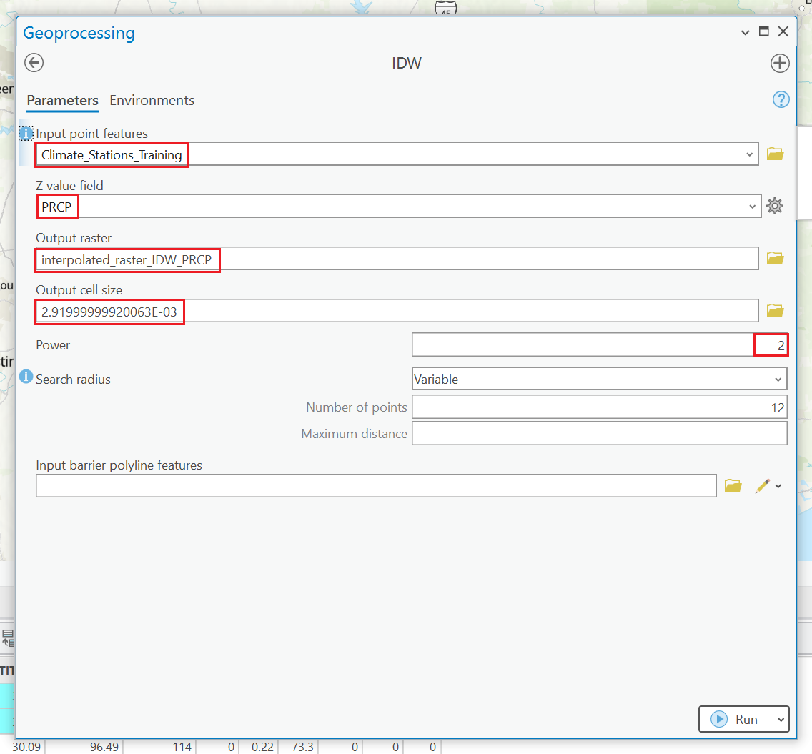
Part 1. Interpolation - IDW
Make sure you are interpolating on the training set.
Apply both ‘IDW’ and ‘Cubic-Spline’ on 2 variables: ‘PRCP’ and ‘TAVG’
Name your output layer properly!!!
Keep the output cell as default
!!! Experiment with the power parameter in IDW!!!

Slide 17
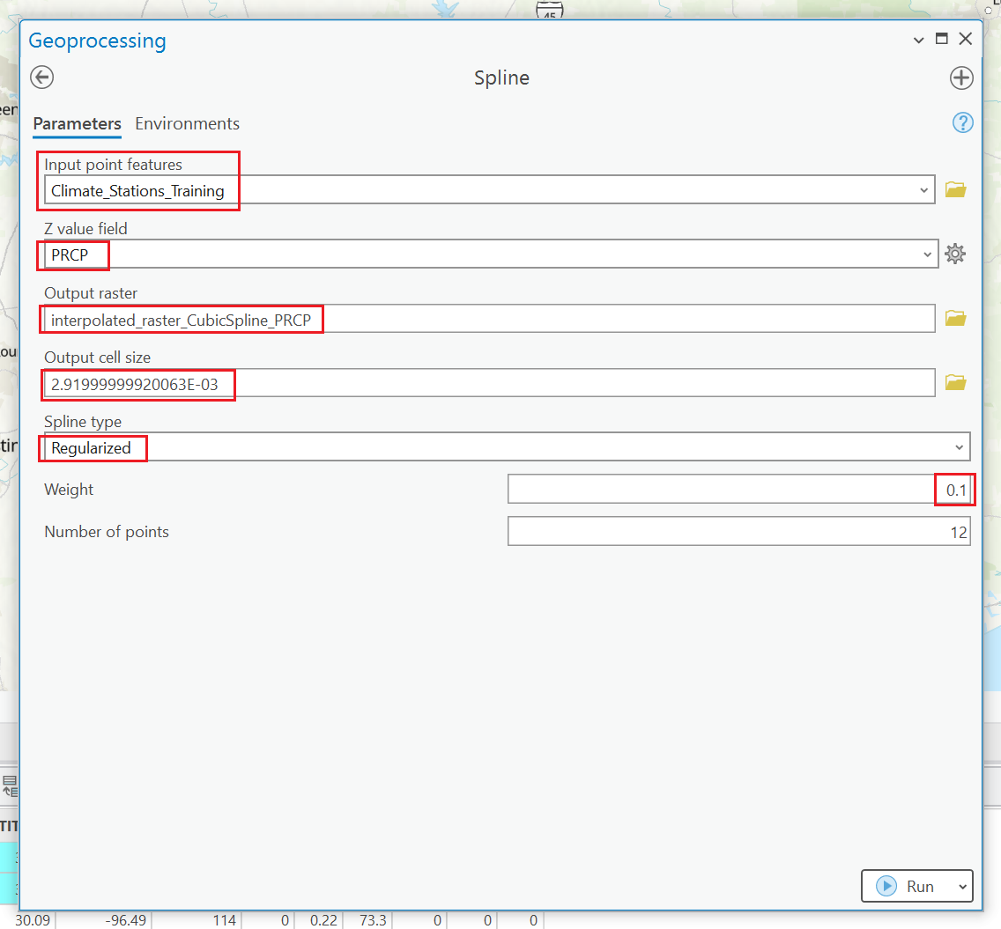
Part 1. Interpolation - CS
Make sure you are interpolating on the training set.
Apply both ‘IDW’ and ‘Cubic-Spline’ on 2 variables: ‘PRCP’ and ‘TAVG’
Name your output layer properly!!!
Keep the output cell as default
!!! Experiment with the Spline Type in Cubic-Spline!!!
Notes:
You can tune with the number of points but make sure you keep the value same in both IDW and CS.

Slide 18
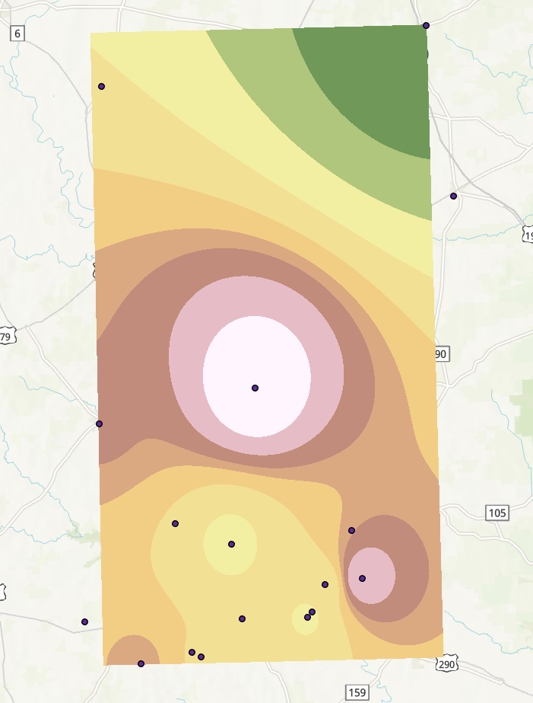
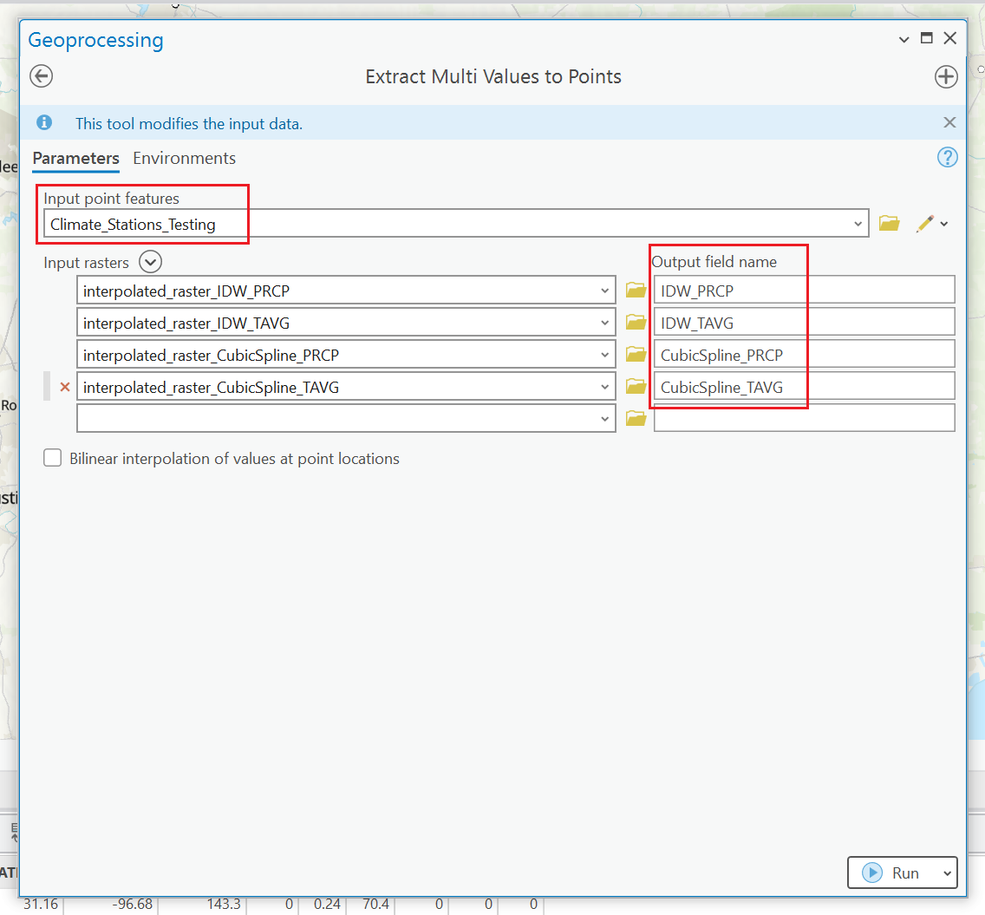
Part 1. Extract Values
Notes:
The interpolated raster layers should look something like this on the left side.,
And the next step is to extract values back to the testing points.
Make sure it’s TESTING set this time!!!
And use extract multi values to save some time.
And name the column properly!!!

Slide 19
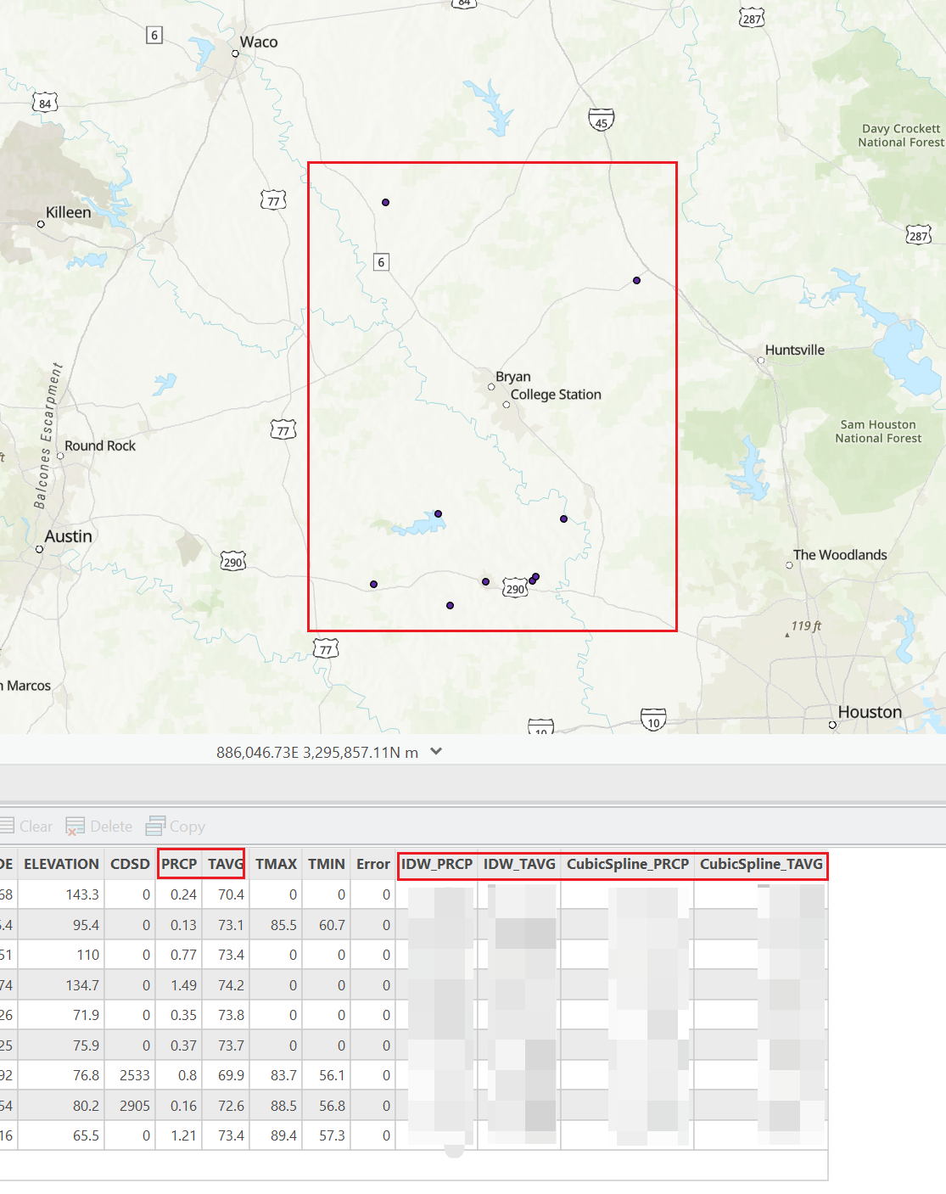
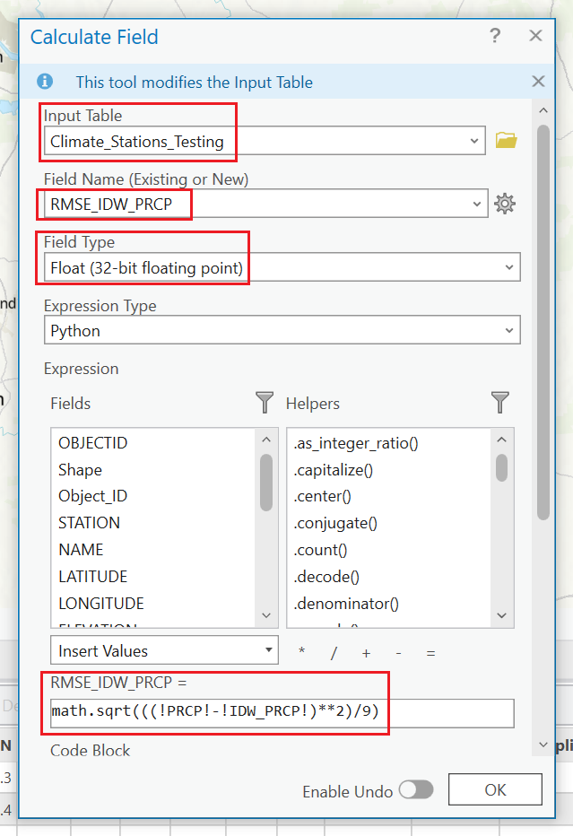
Part 1. Calculate RMSE
Notes:
So that you can get all 4 columns once.
Then calculate RMSE between ground truth and your predicted values using the “Calculate Field” tool.
There will be new columns in the original table.
Then write an expression to generate a new column (field) to calculate the RMSE for columns you want.
There might be NULL values, but it’s fine.
But for the expression, be careful with it. Are you calculating MAE or RMSE?
If you use MAE, it’s fine, but say it in your report it’s MAE.
You will have a few points off if you say it’s RMSE, but actually MAE.

Slide 20
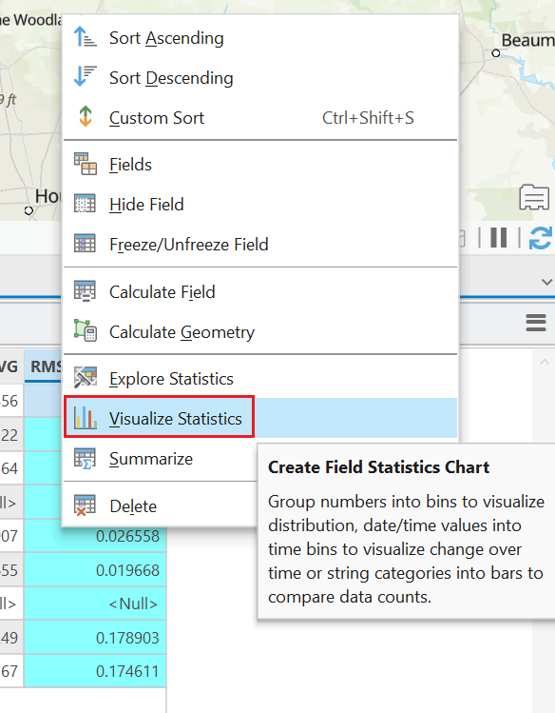
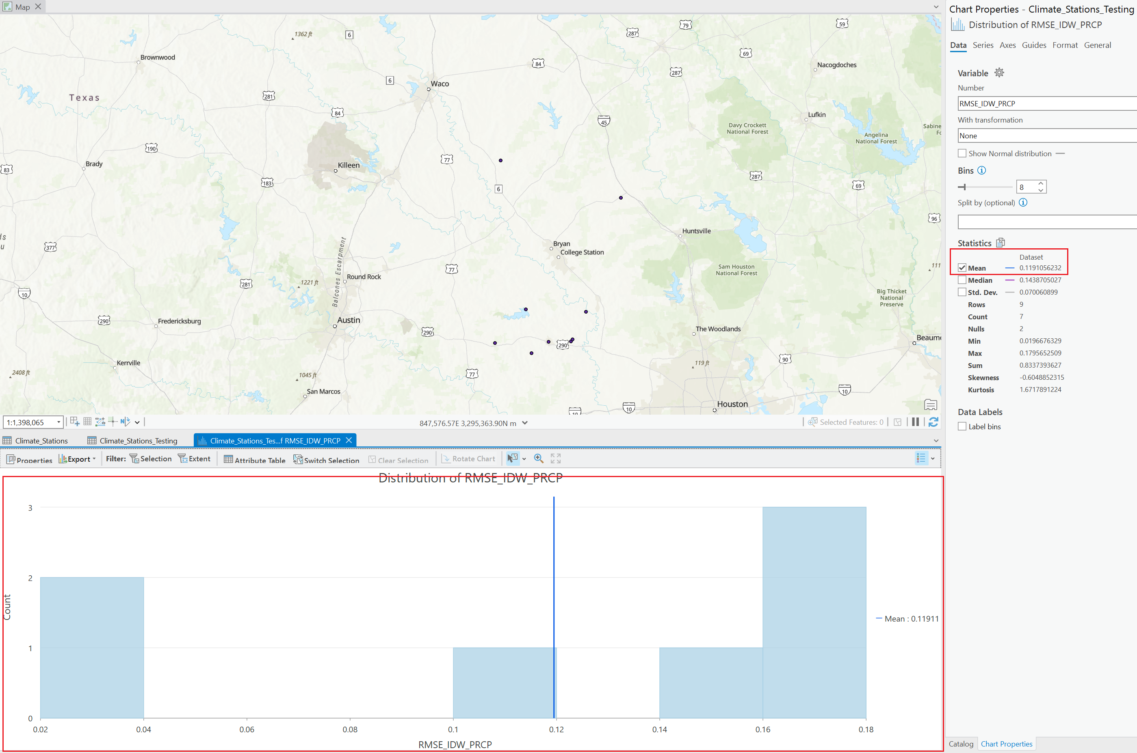
Part 1. RMSE Statistics
Notes:
Finally we have the statistical analysis on RMSE for IDW on PRCP in this format.
I need to see this histogram, and the mean value.

Slide 21
Part1.Tasks
Load Climate Station Point data and split into Training and Evaluating sets.
Apply interpolation algorithms on training set.
IDW
Cubic-Spline
Extract values from the interpolated layer onto the evaluating points.
Compare the predicted values and the ground truth by calculating RMSE
Tune params in interpolation, analyze the changes and interpret your findings.

Slide 22
Part1.Expr Questions
Compare and contrast interpolated precipitation and temperature values for the interpolation algorithms.
What was the RMS error associated with each algorithm using default parameter values?
Can you explain why each algorithm produced the magnitude of error it did?
2. Did modification of the parameters for a specific algorithm modify the RMSE?
3. Did different algorithms produce a different spatial distribution of precipitation and temperature? How did you determine if the spatial patterns and magnitudes were different?

Slide 23
Want a break?

Slide 24
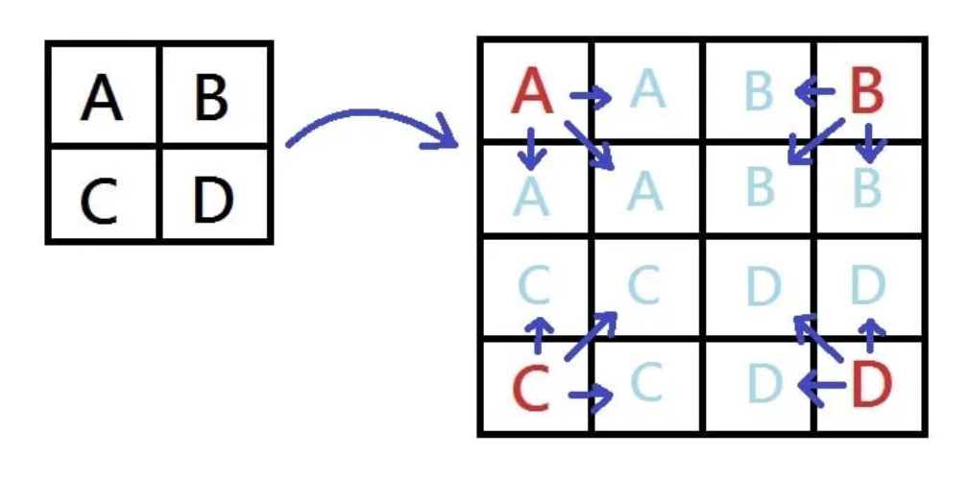
Resampling Algos – Nearest Neighbor
Pros:
Simple
Cons:
Information Loss
Looks blocky

Slide 25
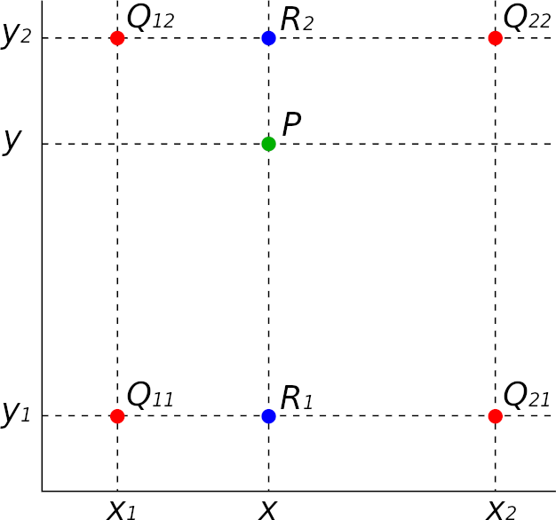
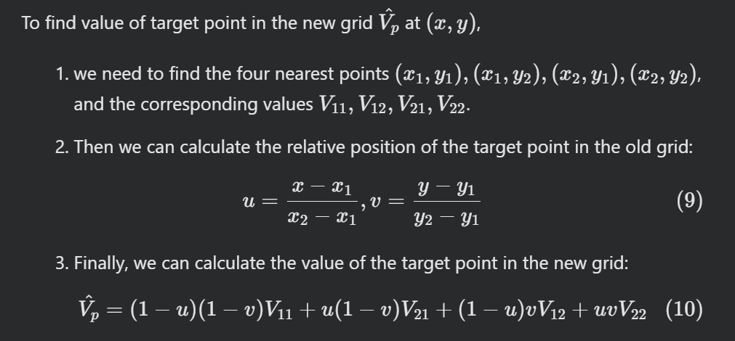
Resampling Algos – Bilinear

Slide 26
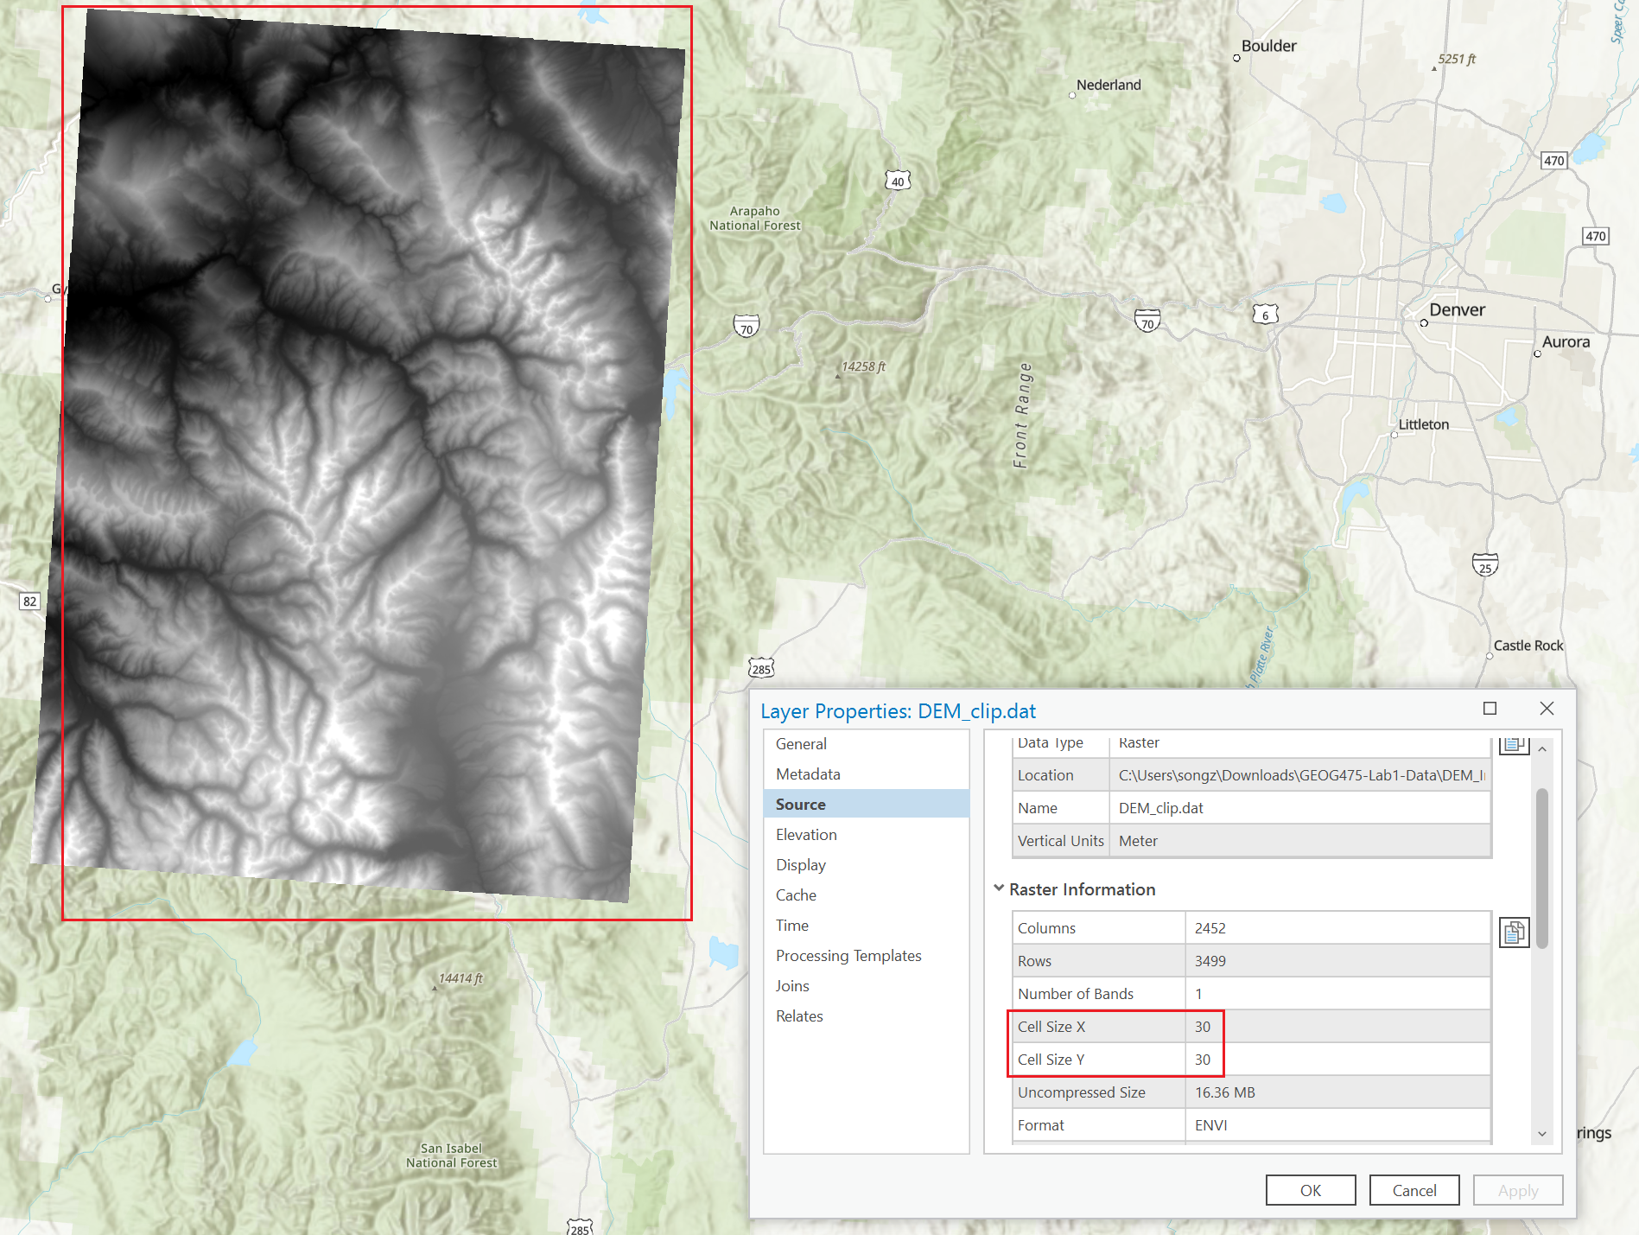
Source Data – DEM

Slide 27
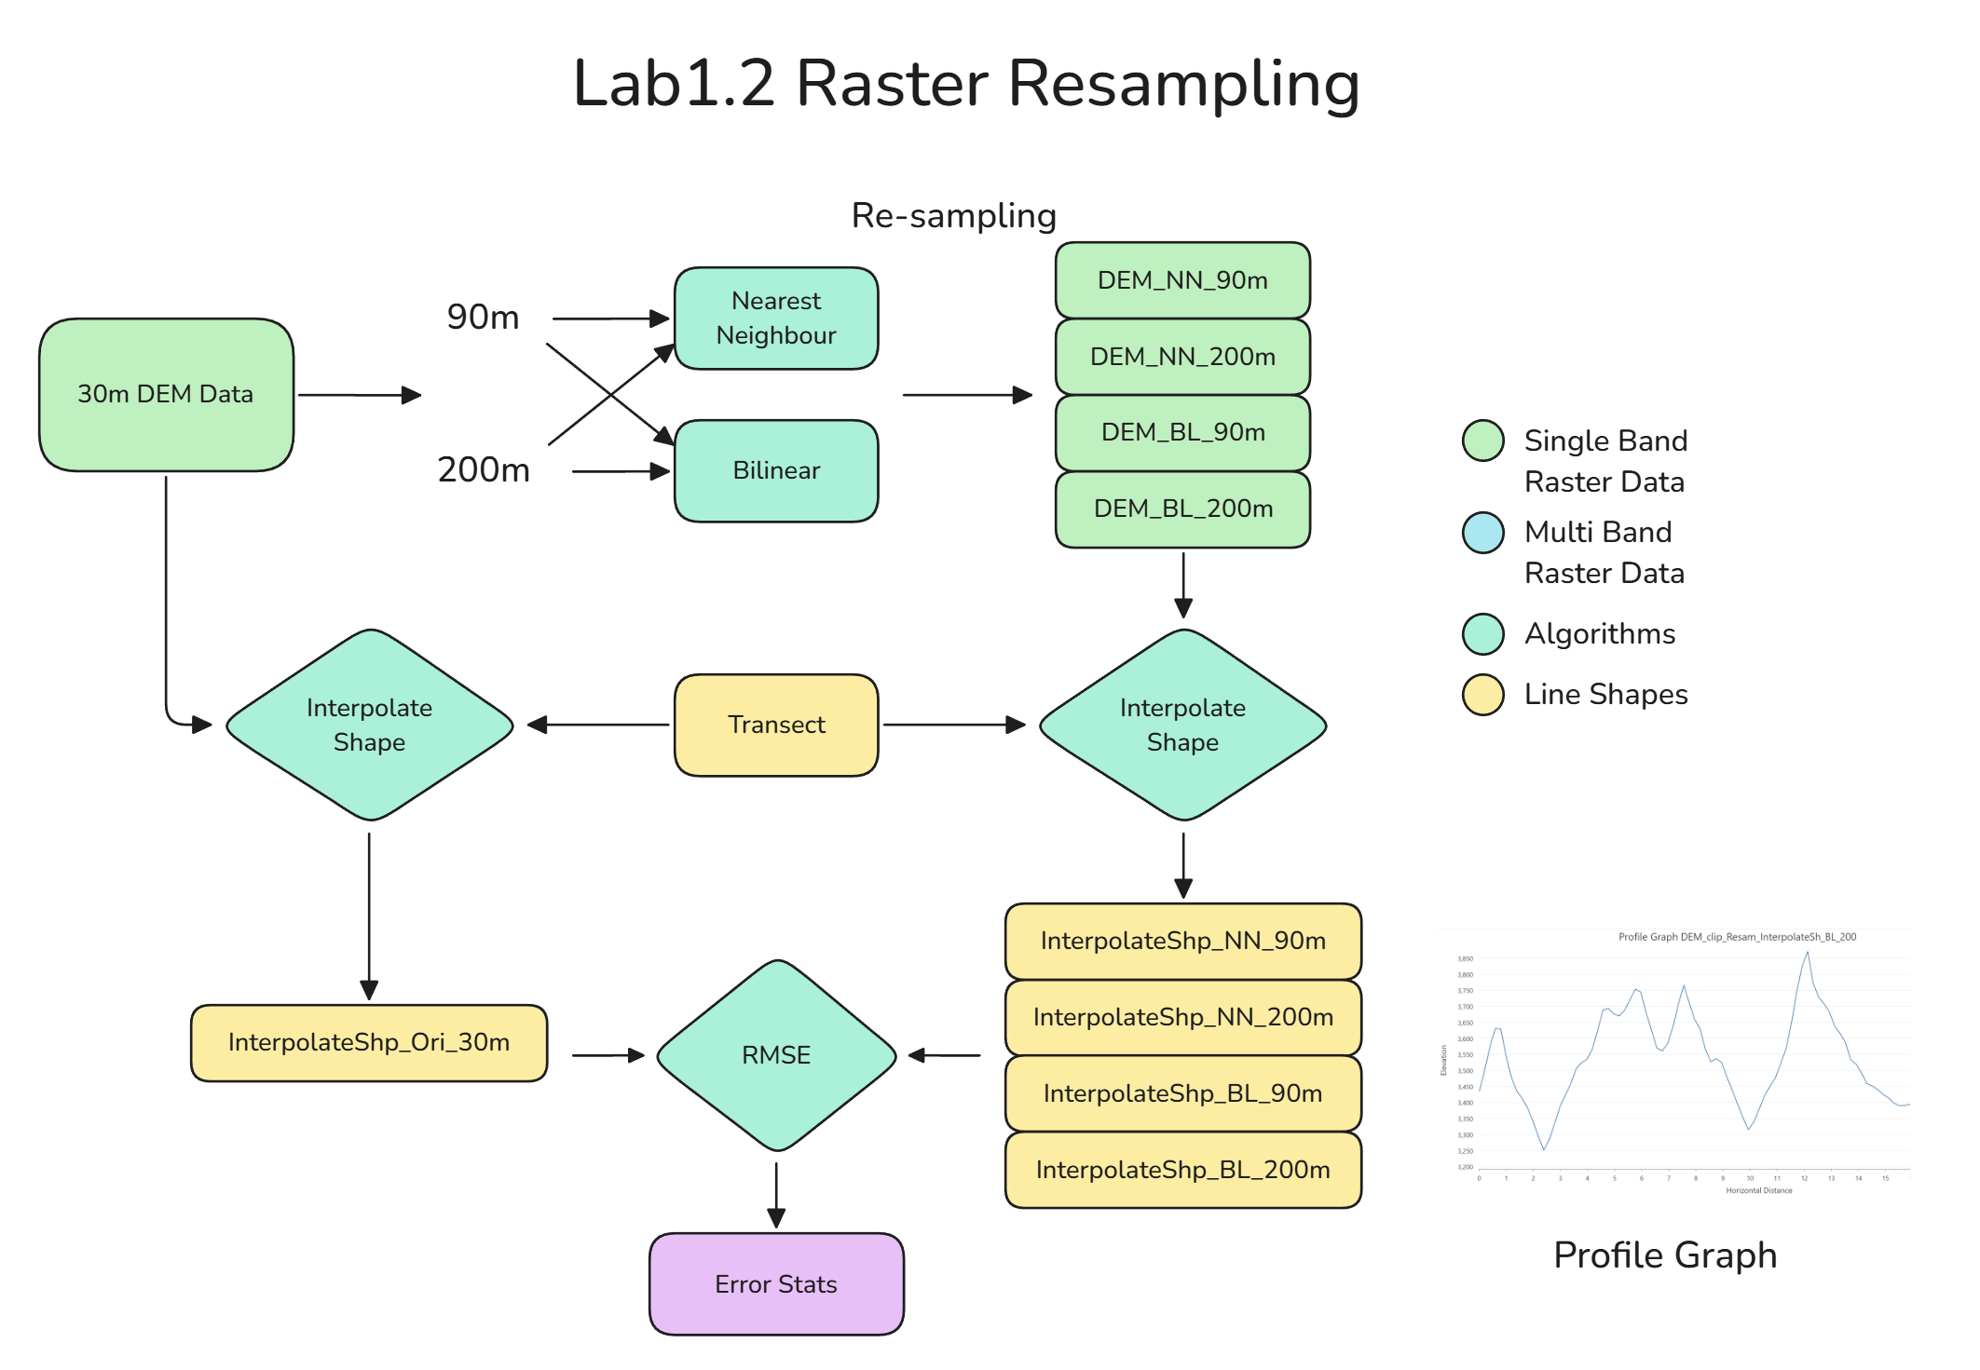
Part 2. Resampling

Slide 28
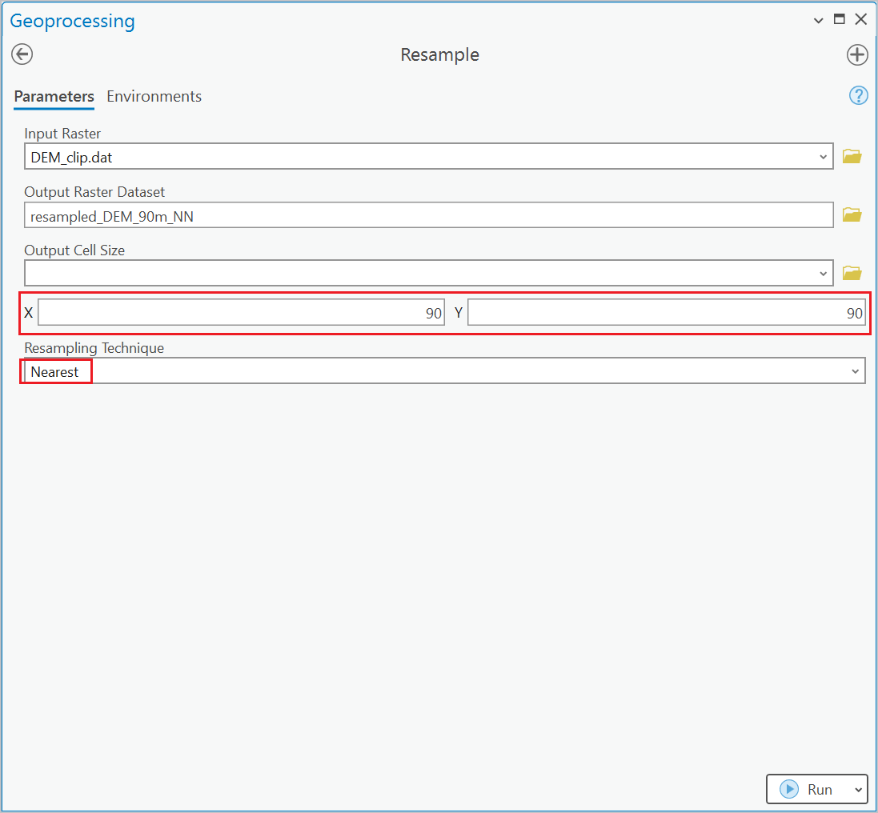
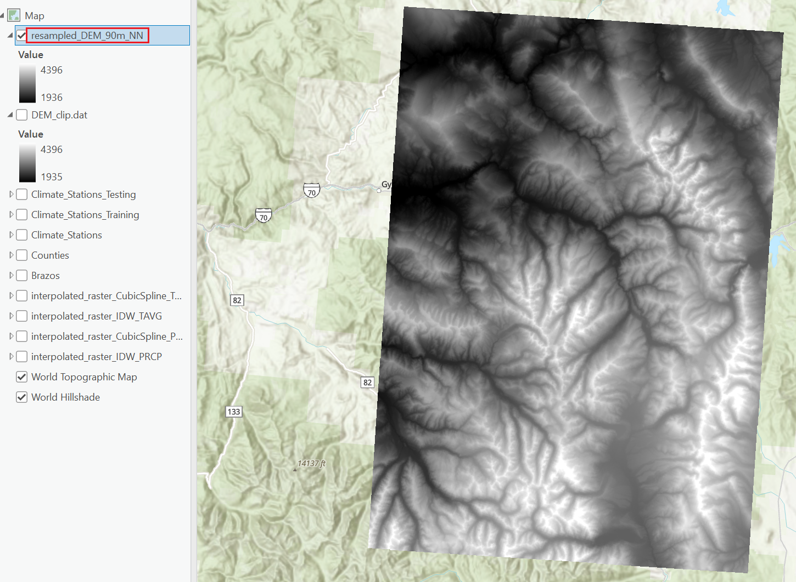
Part 2. Resampling

Slide 29
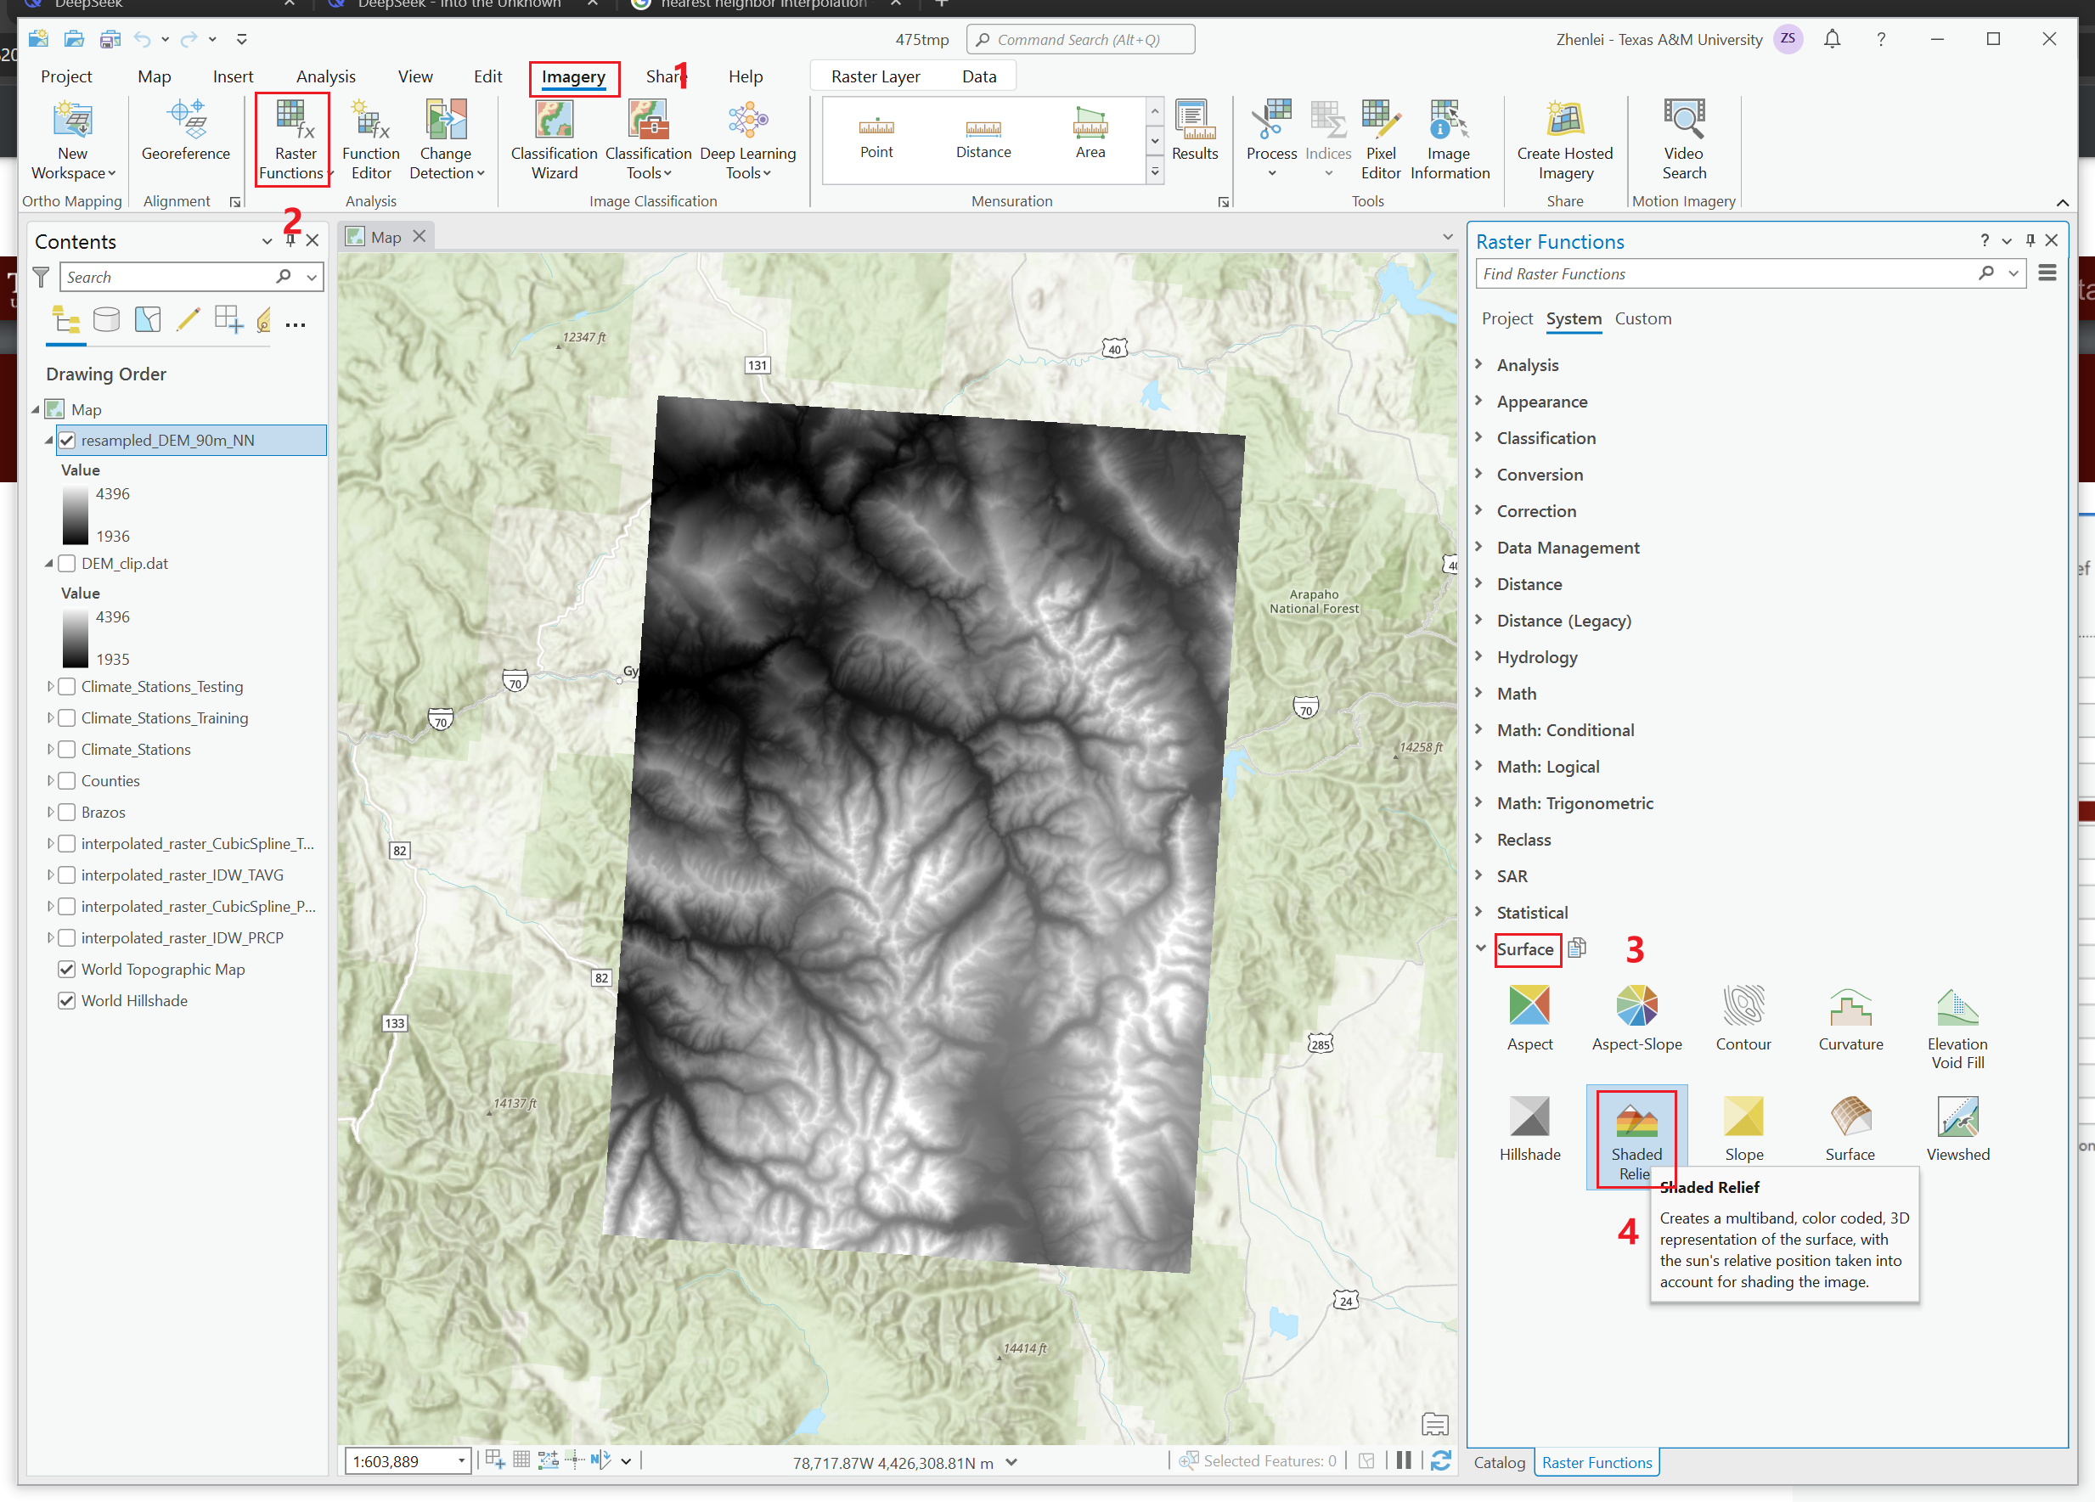
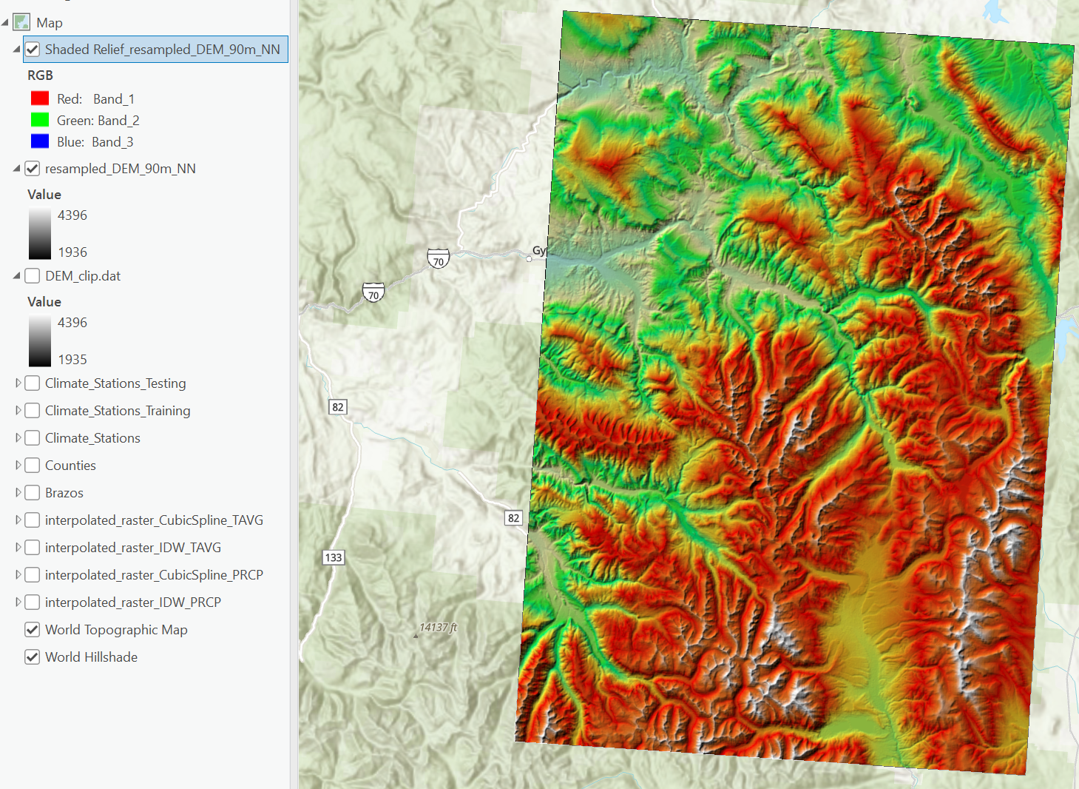
Part 2. Add Coloramp
Notes:
Just use the default values.

Slide 30
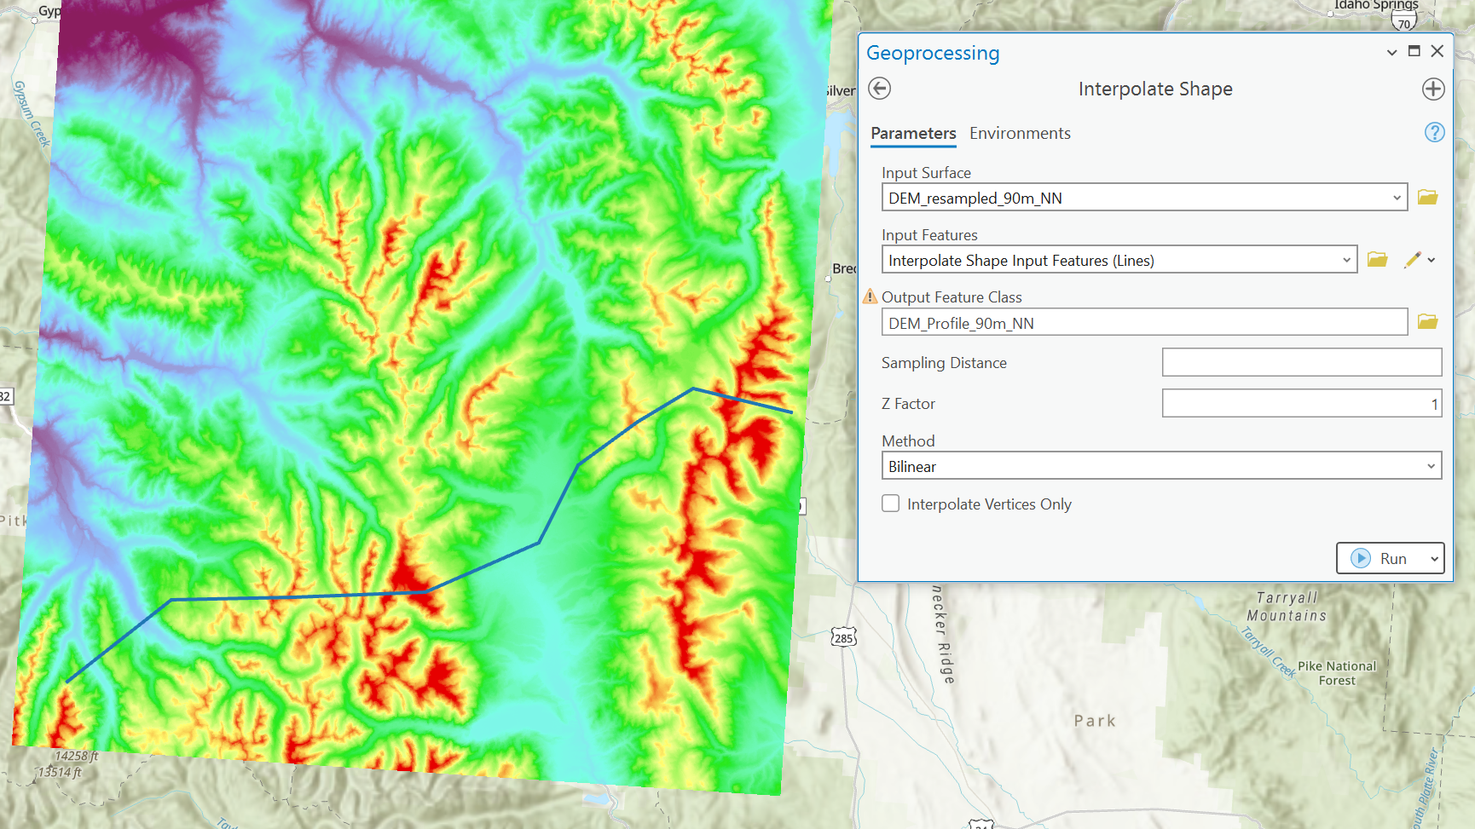
Part 2. Interpolate with transect
Notes:
Use the single band raster as input here!
The colorramped raster layer is just for telling the terrain.
And again, name your output layer properly. Don’t get lost by yourself.
The transect you pick should include at least 6 vertices, it’s easier to extract Z values to these vertices to compare RMSE later.

Slide 31
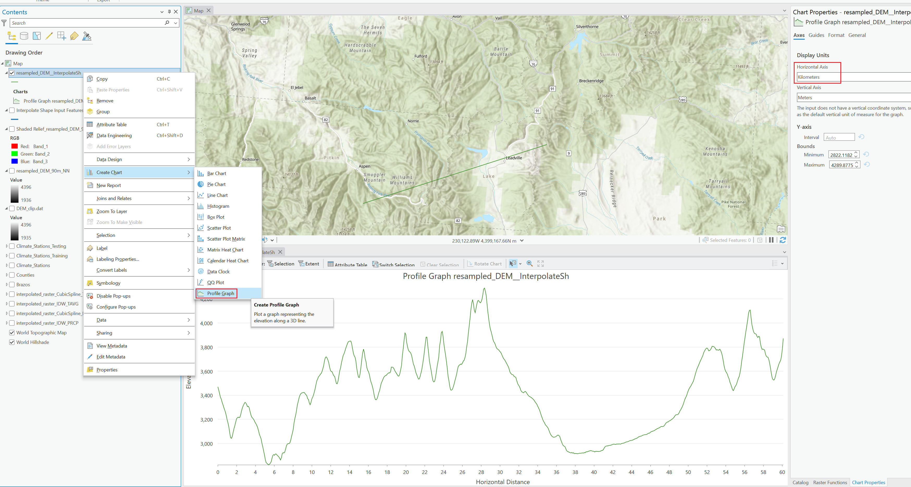
Part 2. Profile Graph

Slide 32
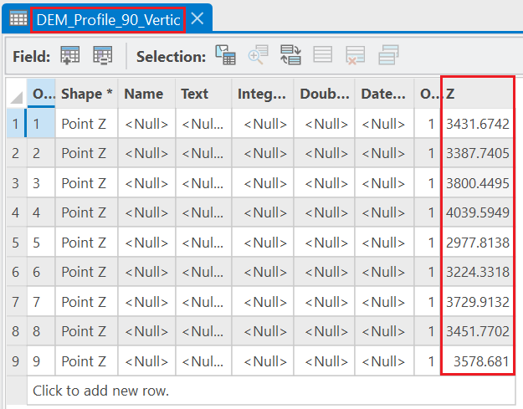
Part 2. Interpolated Line RMSE
Extract Z values to vertices of the transect line
Use vertex Z values from original 30m DEM as the ground truth
Compare predicted vertices Z values from 4 groups to the ground truth by RMSE.
Notes:
Profile graph is not the end.
We finally need to get the RMSE to see how was the predicted (interpolated) elevation profiles.
Feature vertices to points
Calculate geometry attributes (Z values).

Slide 33
Part2.Tasks
Load 30m DEM data.
Resample it into lower resolutions with 2 algorithms:
90m and 200m
Nearest Neighbor (NN), and Bilinear
Add color ramp to the resampled raster layers.
This step is for visual purpose.
Interpolate resampled layers to shape and draw profile graph.
Manually draw a transect as the interpolating shape.
Use bilinear at this step.
Adjust x-axis units to make numbers in regular intervals.
Compare RMSE among Z values of all interpolated polylines

Slide 34
Part2. Expr Questions
Examine the topography at grid cell scales of 30m, 90m and 200m. You may need to use shaded-relief images to examine the spatial patterns in the topography.
Describe how the topography is represented compared to the 30 meter DEM.
2. Compare and contrast the DEMs at a particular scale generated using different interpolation algorithms.
Does the type of interpolation algorithm at a particular scale influence the nature of the topography depicted in the shaded-relief images?
3. Compare and contrast the interpolation algorithms that were used to generate topographic profiles. Do this for all two grid-cell scales.
Which algorithm is most accurate? How did you determine this? Can you produce quantitative evidence?

Slide 35
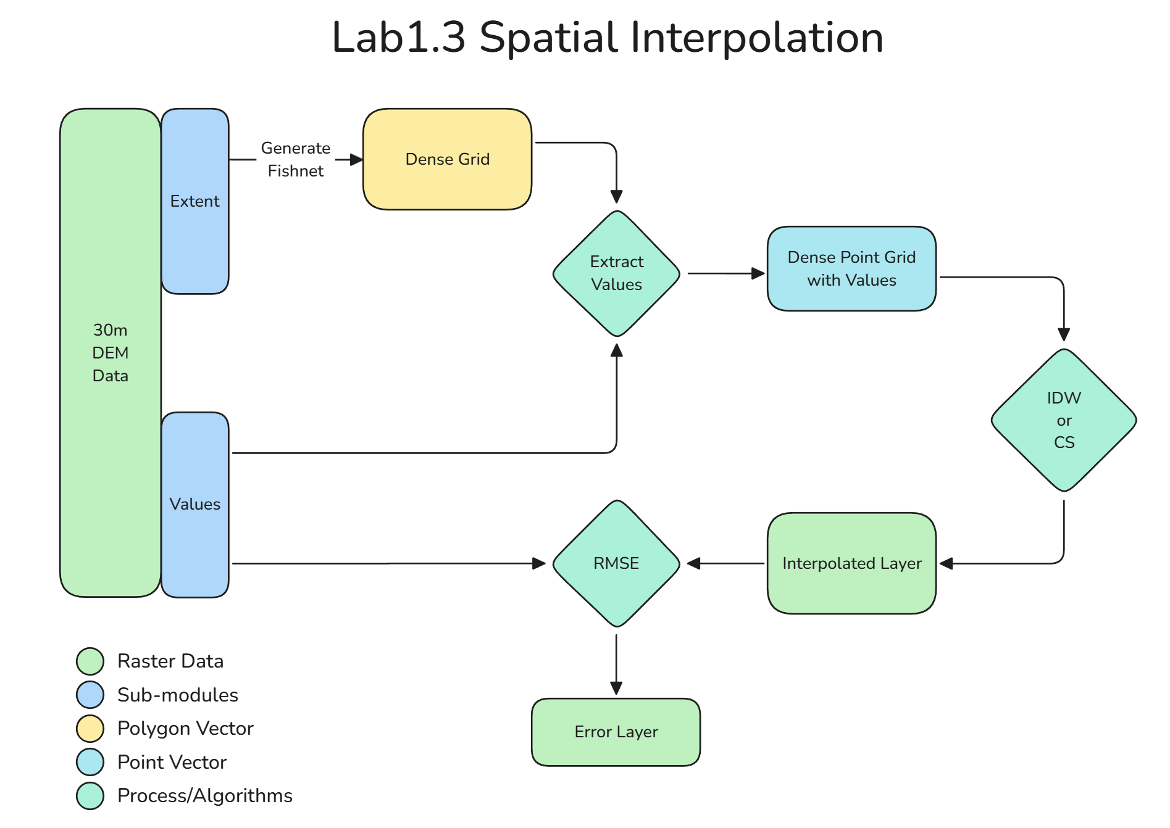
Part 3. Spatial Interpolation

Slide 36
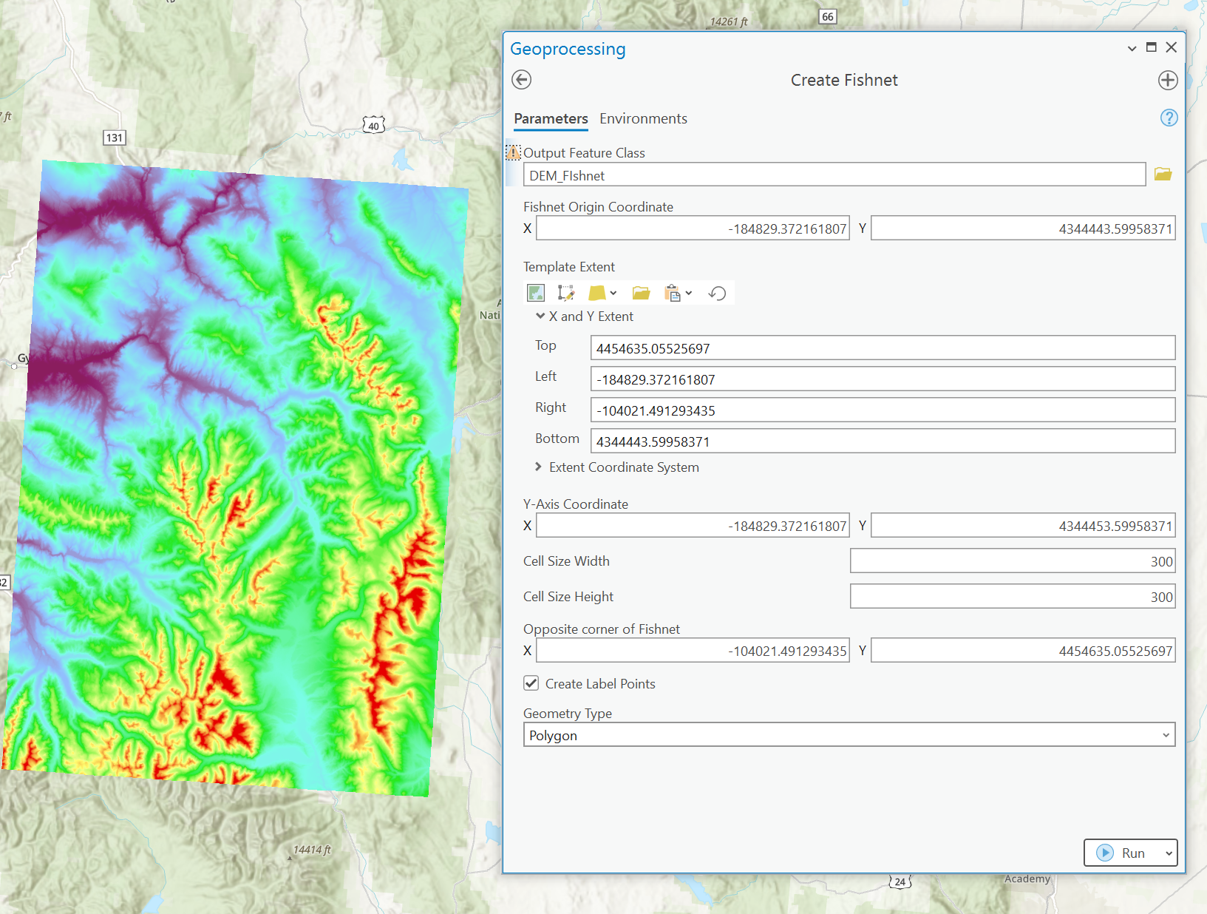
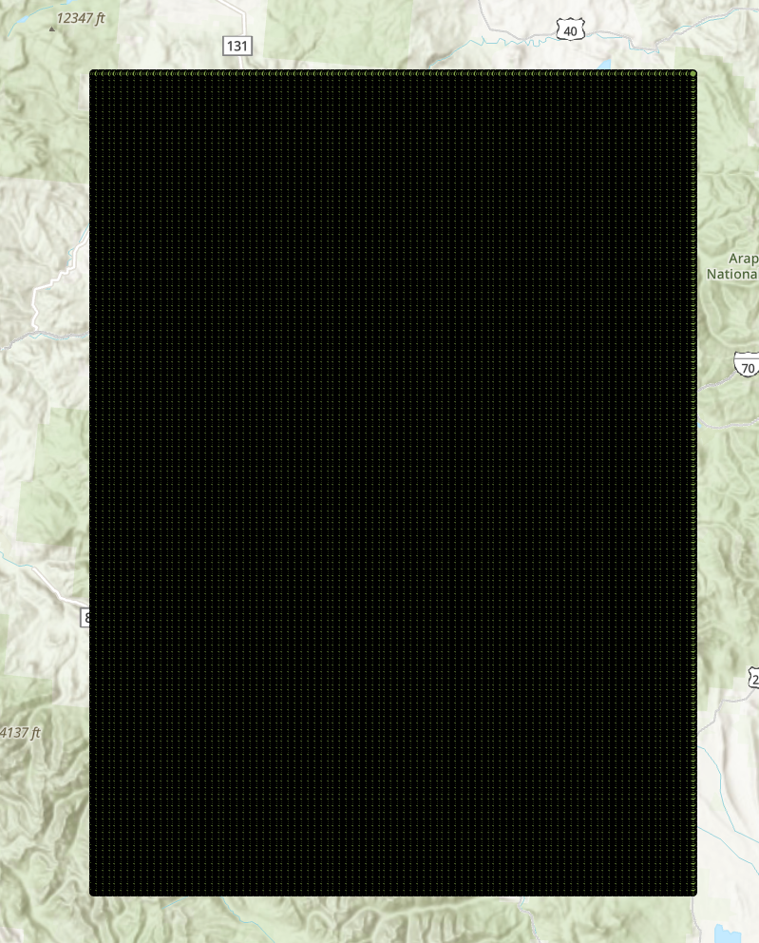
Part 3. Spatial Interpolation

Slide 37
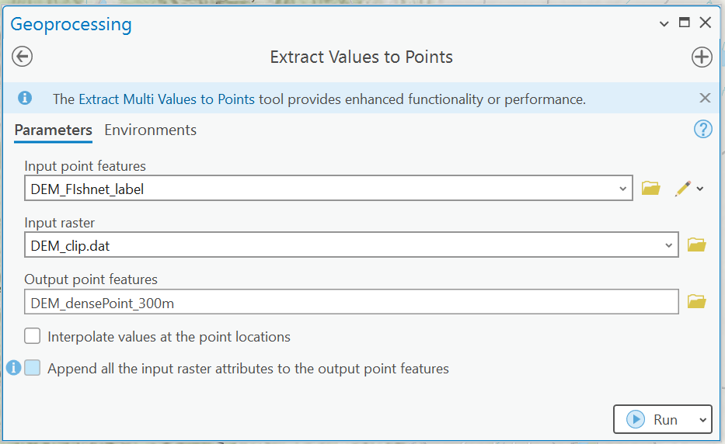
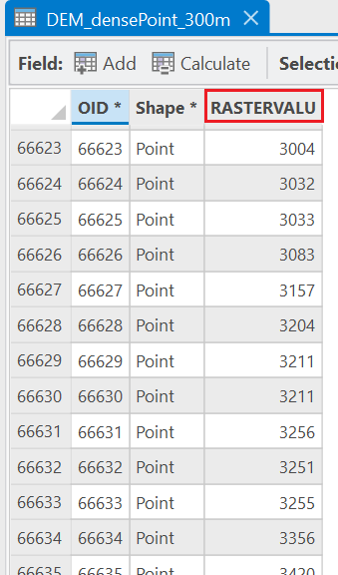
Part 3. Spatial Interpolation

Slide 38
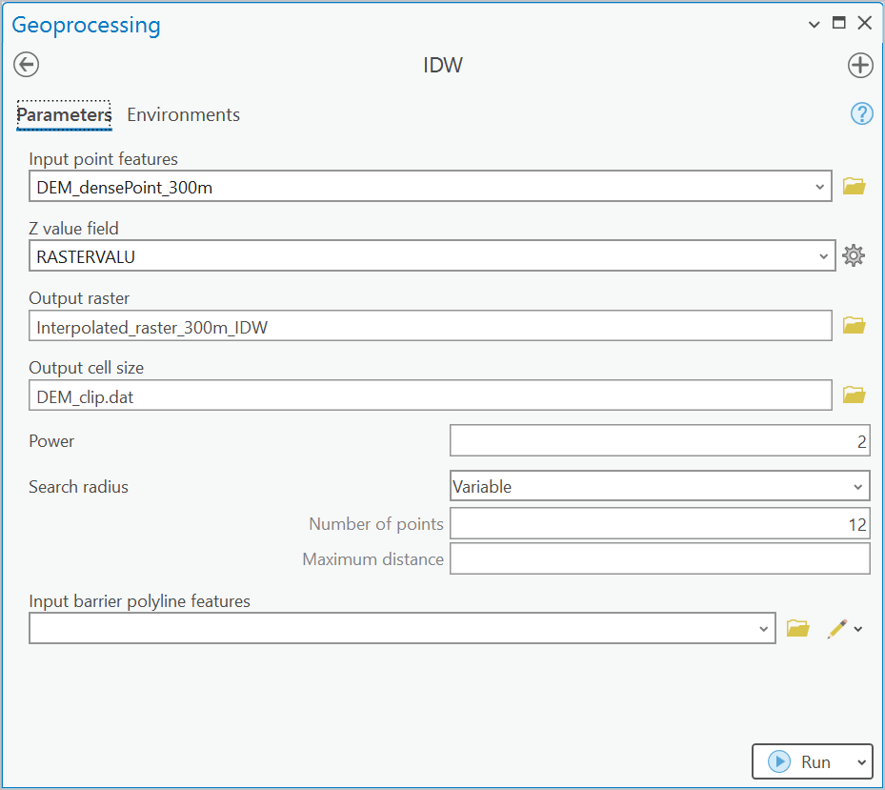
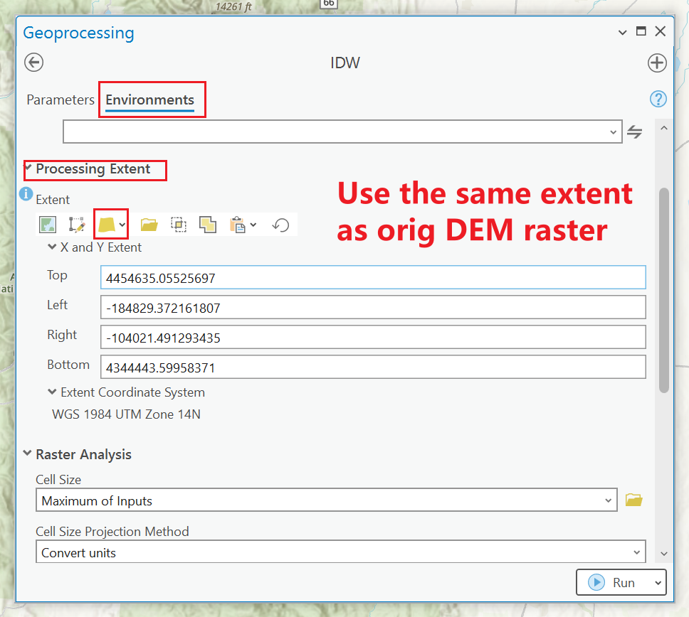
Part 3. Spatial Interpolation

Slide 39
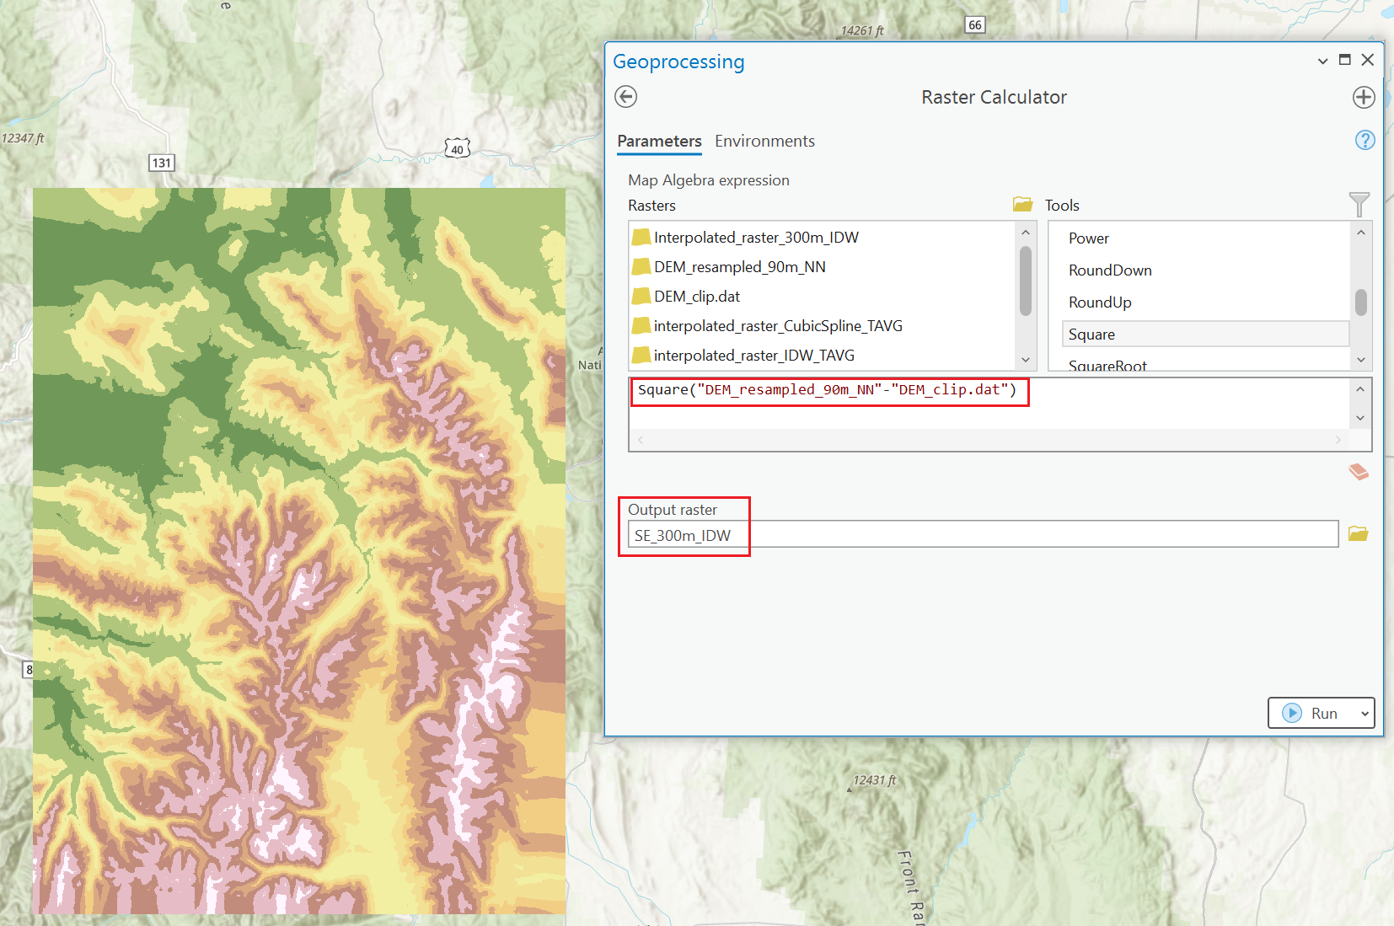
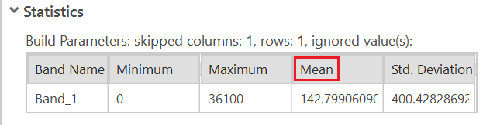
Part 3. Raster RMSE
Also interpolate with Cubic-Spline algorithm
Use raster calculator to get RMSE between interpolated and the original rasters.
Experiment with params of IDW and CS. And explain your findings.

Slide 40
Part3.Tasks
Load 30m DEM data.
Generate 300m*300m dense point grid with extracted values from original DEM, with the same extent.
Interpolate from this dense point grid to a new raster using IDW and Cubic-Spline.
Calculate error raster layer using raster calculator , between original raster and the interpolated raster layer.
Tune algorithms’ params and interpret your findings about the changes.

Slide 41
Part3. Expr Questions
Compare and contrast the results from the IDW algorithm to the original data.
Did the use of different parameter settings influence the results to any degree?
Did different parameter settings generate different spatial patterns in topography? Was there a difference in terms of the global RMSE?
2. Compare and contrast interpolation results using the cubic spline algorithm.
Did the use of different parameter settings influence the results to any degree?
Did different parameter settings generate different spatial patterns in topography? Was there a difference in terms of the global RMSE?
3. Which algorithm produced the best results? How did you determine this?
4. If the sampling of the points from the original DEM were closer together or further away from each other,
do you think that the same algorithm would produce the best results?
If you think this is so, would you use the same parameters?
If not, explain why.
5. Knowing what you now know, how would you produce the best interpolation results for the climate data that you worked with earlier (don’t do the work, just describe what you could do differently to produce better results). Be sure to justify the reasons for your decision.

Slide 42
Submission
A .doc/docx file includes:
Contexts and necessary screenshots (with captions) to prove you completed all required steps.
Comparisons of performances with different algorithms and parameter settings. Describe what changes did you make and what’s changed.
Answer the designated questions with YOUR OWN interpretation.

Slide 43
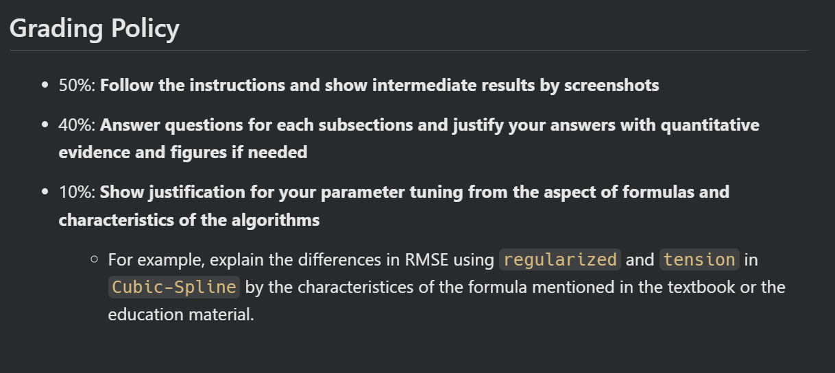
Grading Rule

Slide 44
The End

